Slide 1



Every Child is Special
LEXආයුධ
AI-based Personalized Rehabilitation for Dyslexia and Dyscalculia Adolescents
Group ID: 24-25J-233

Slide 2
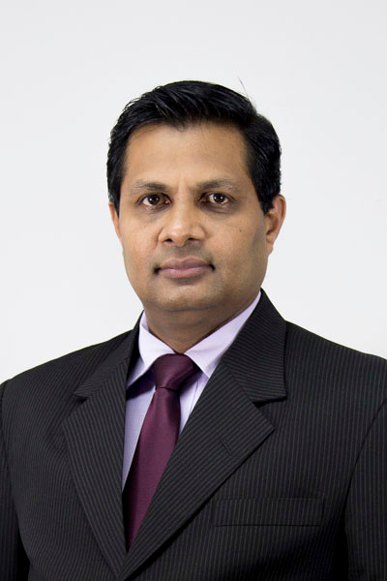
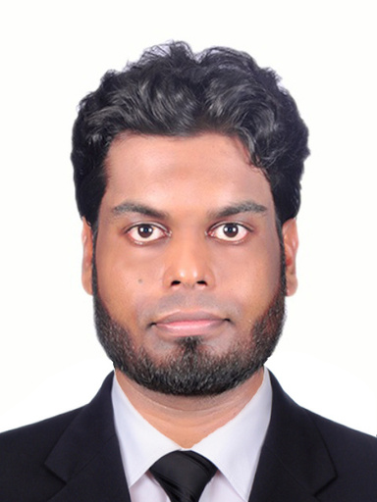

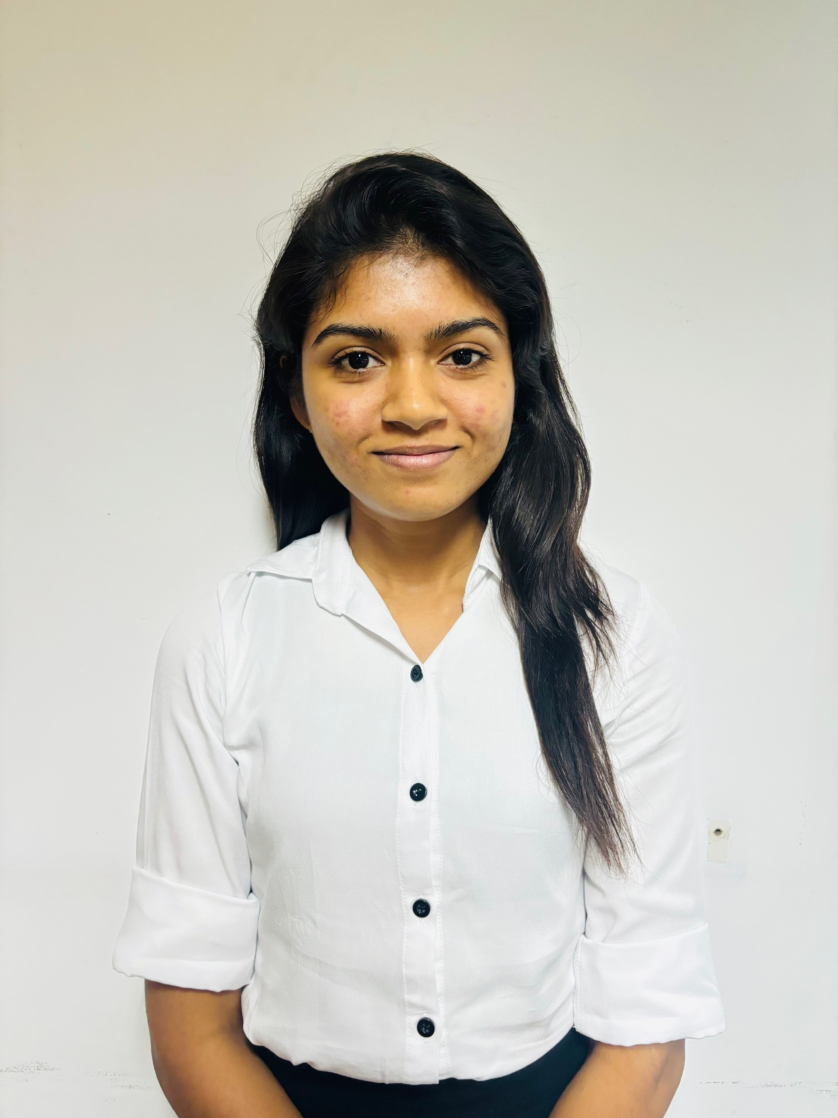
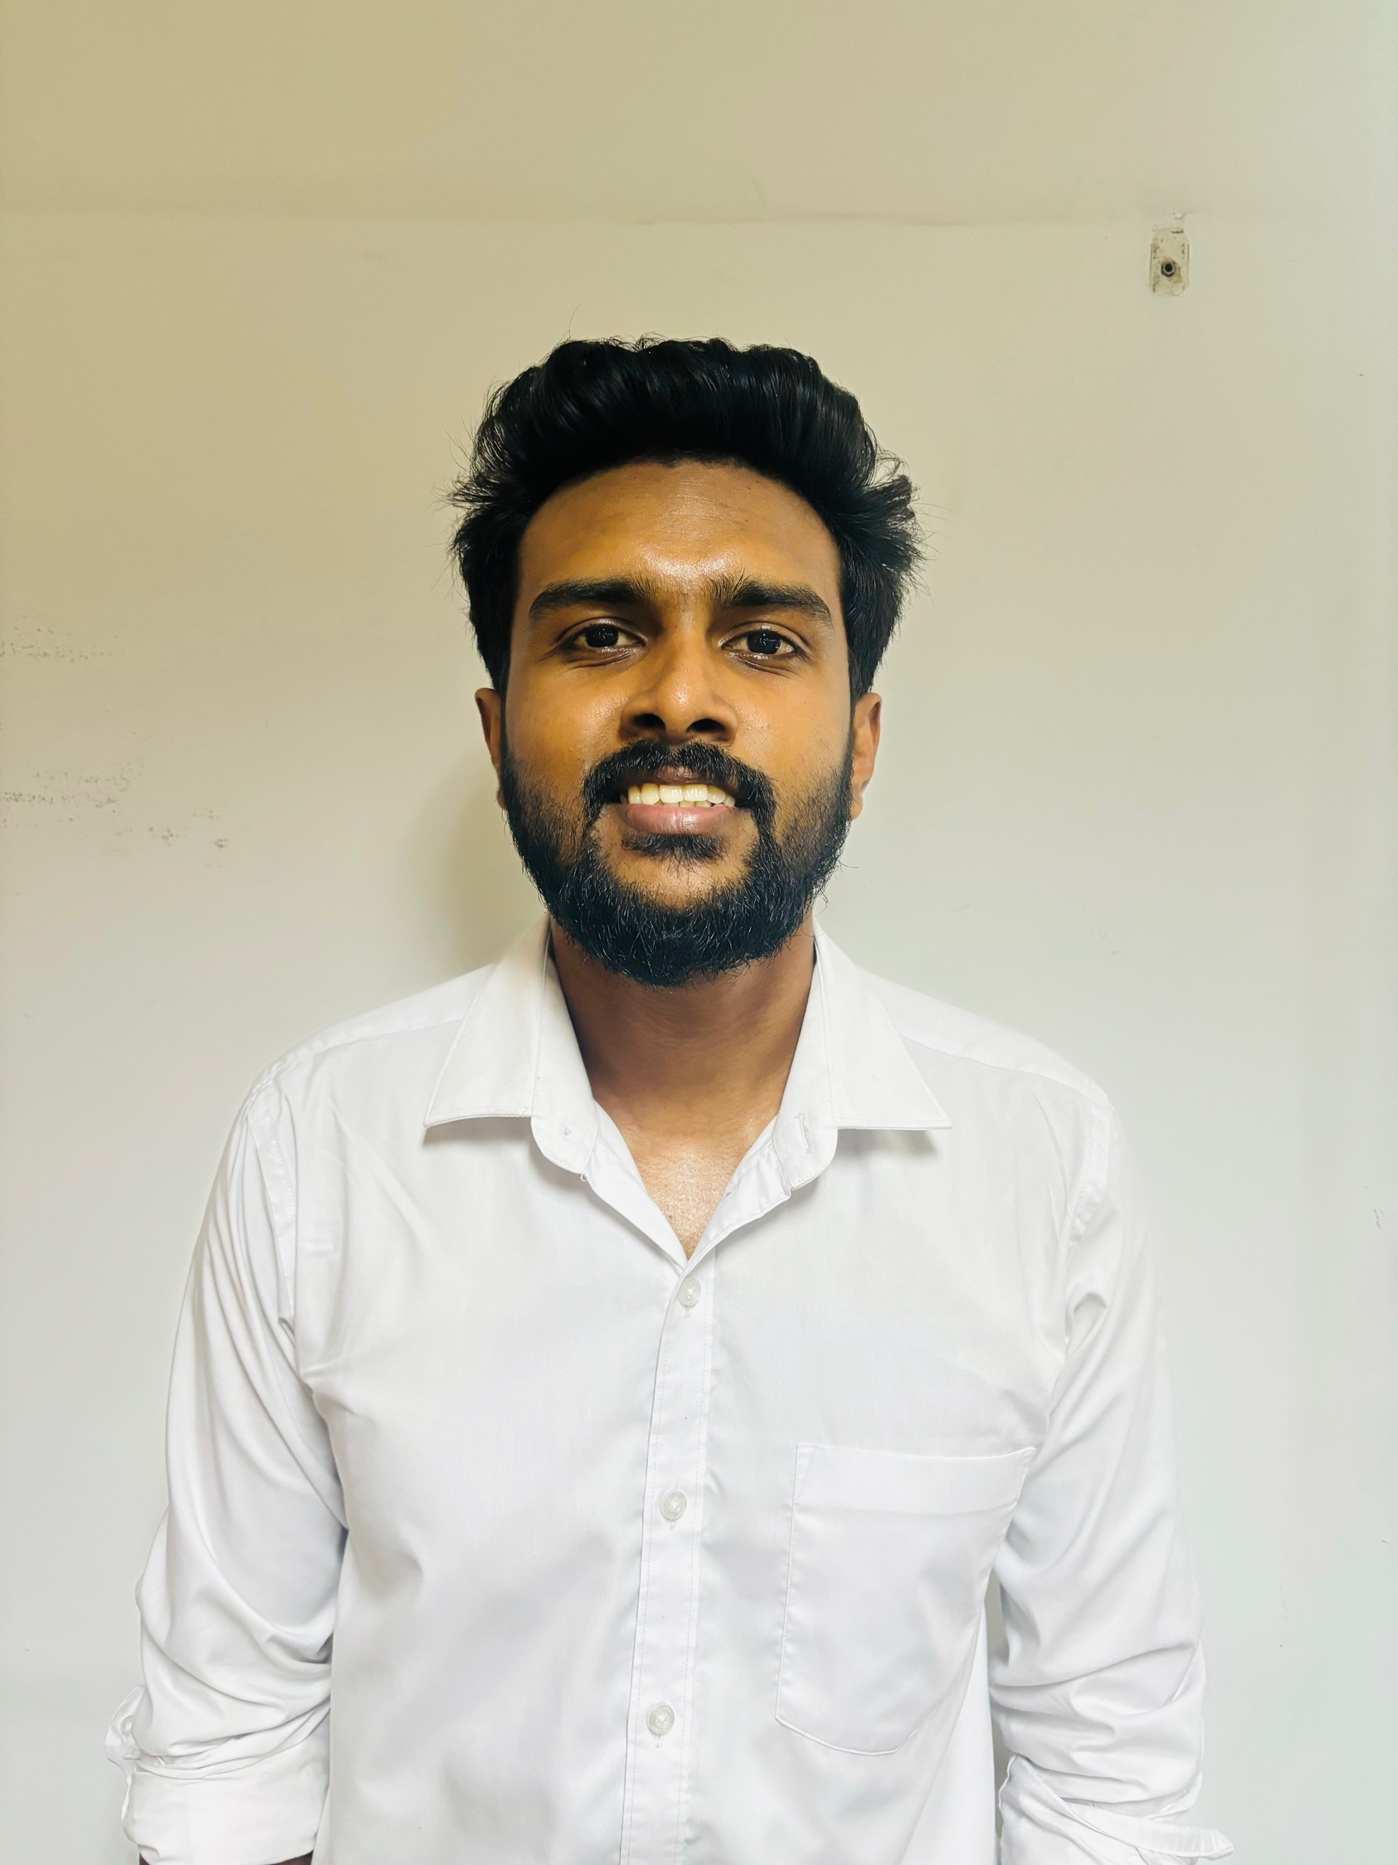
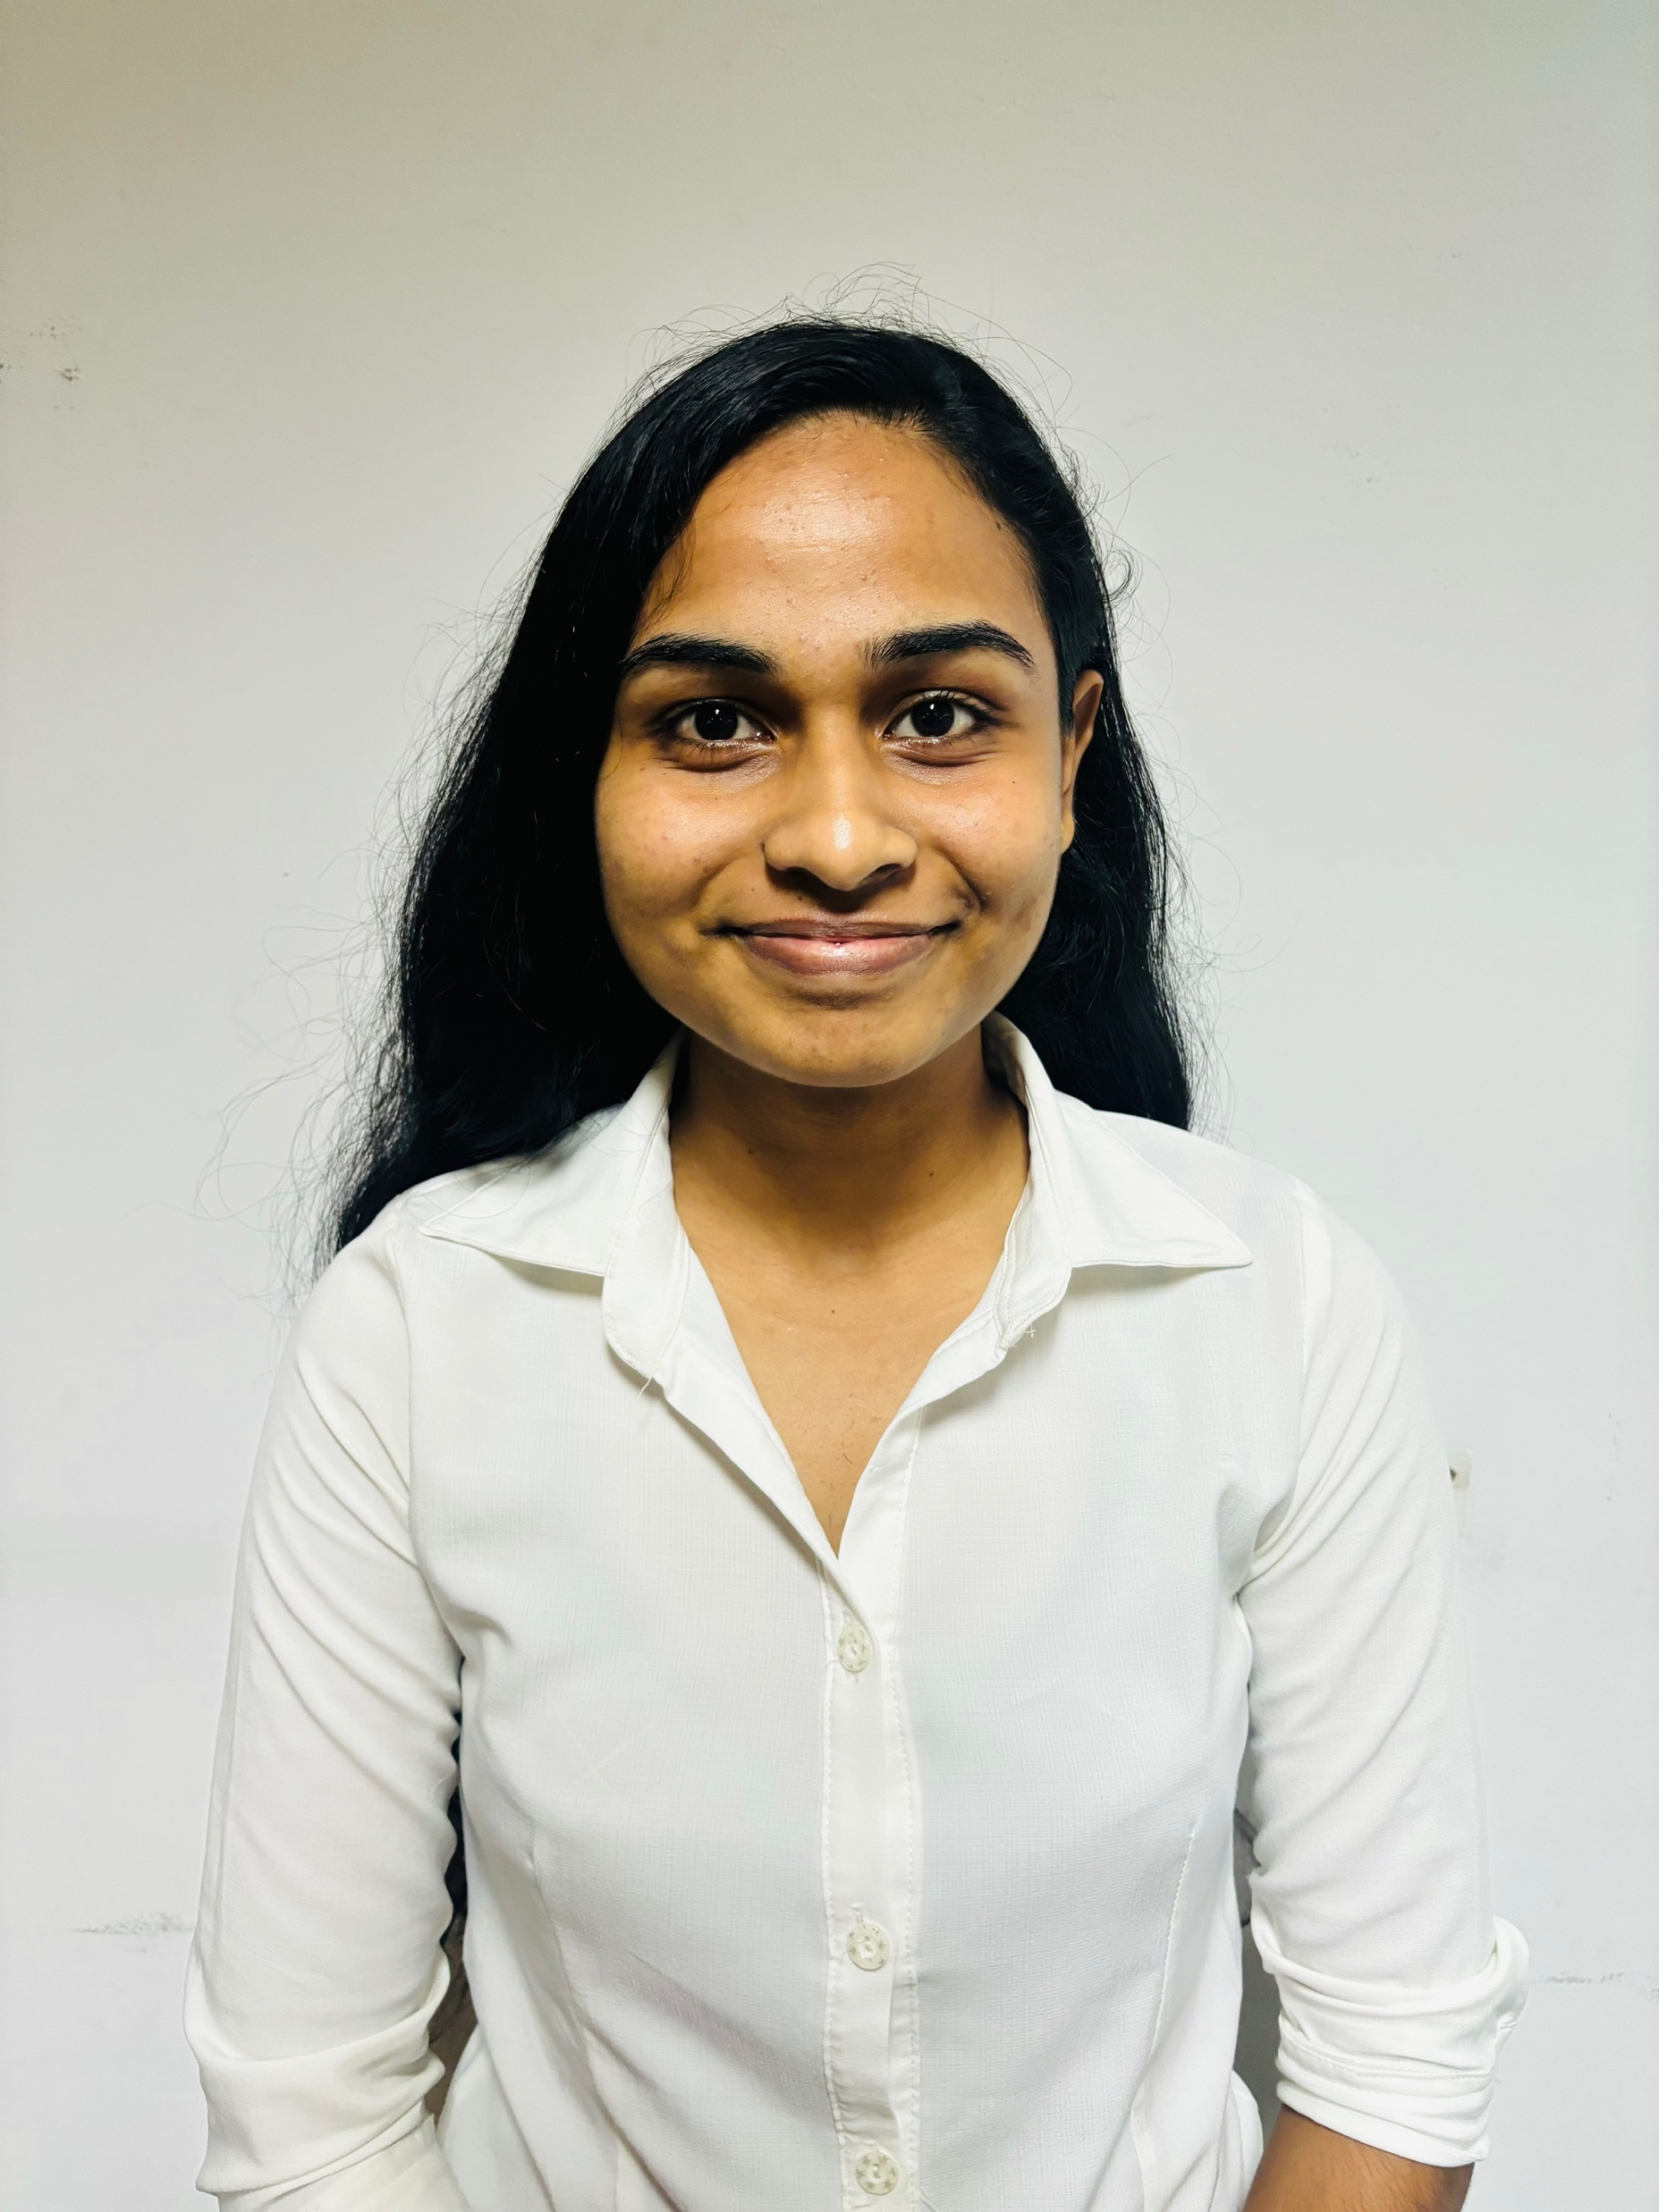
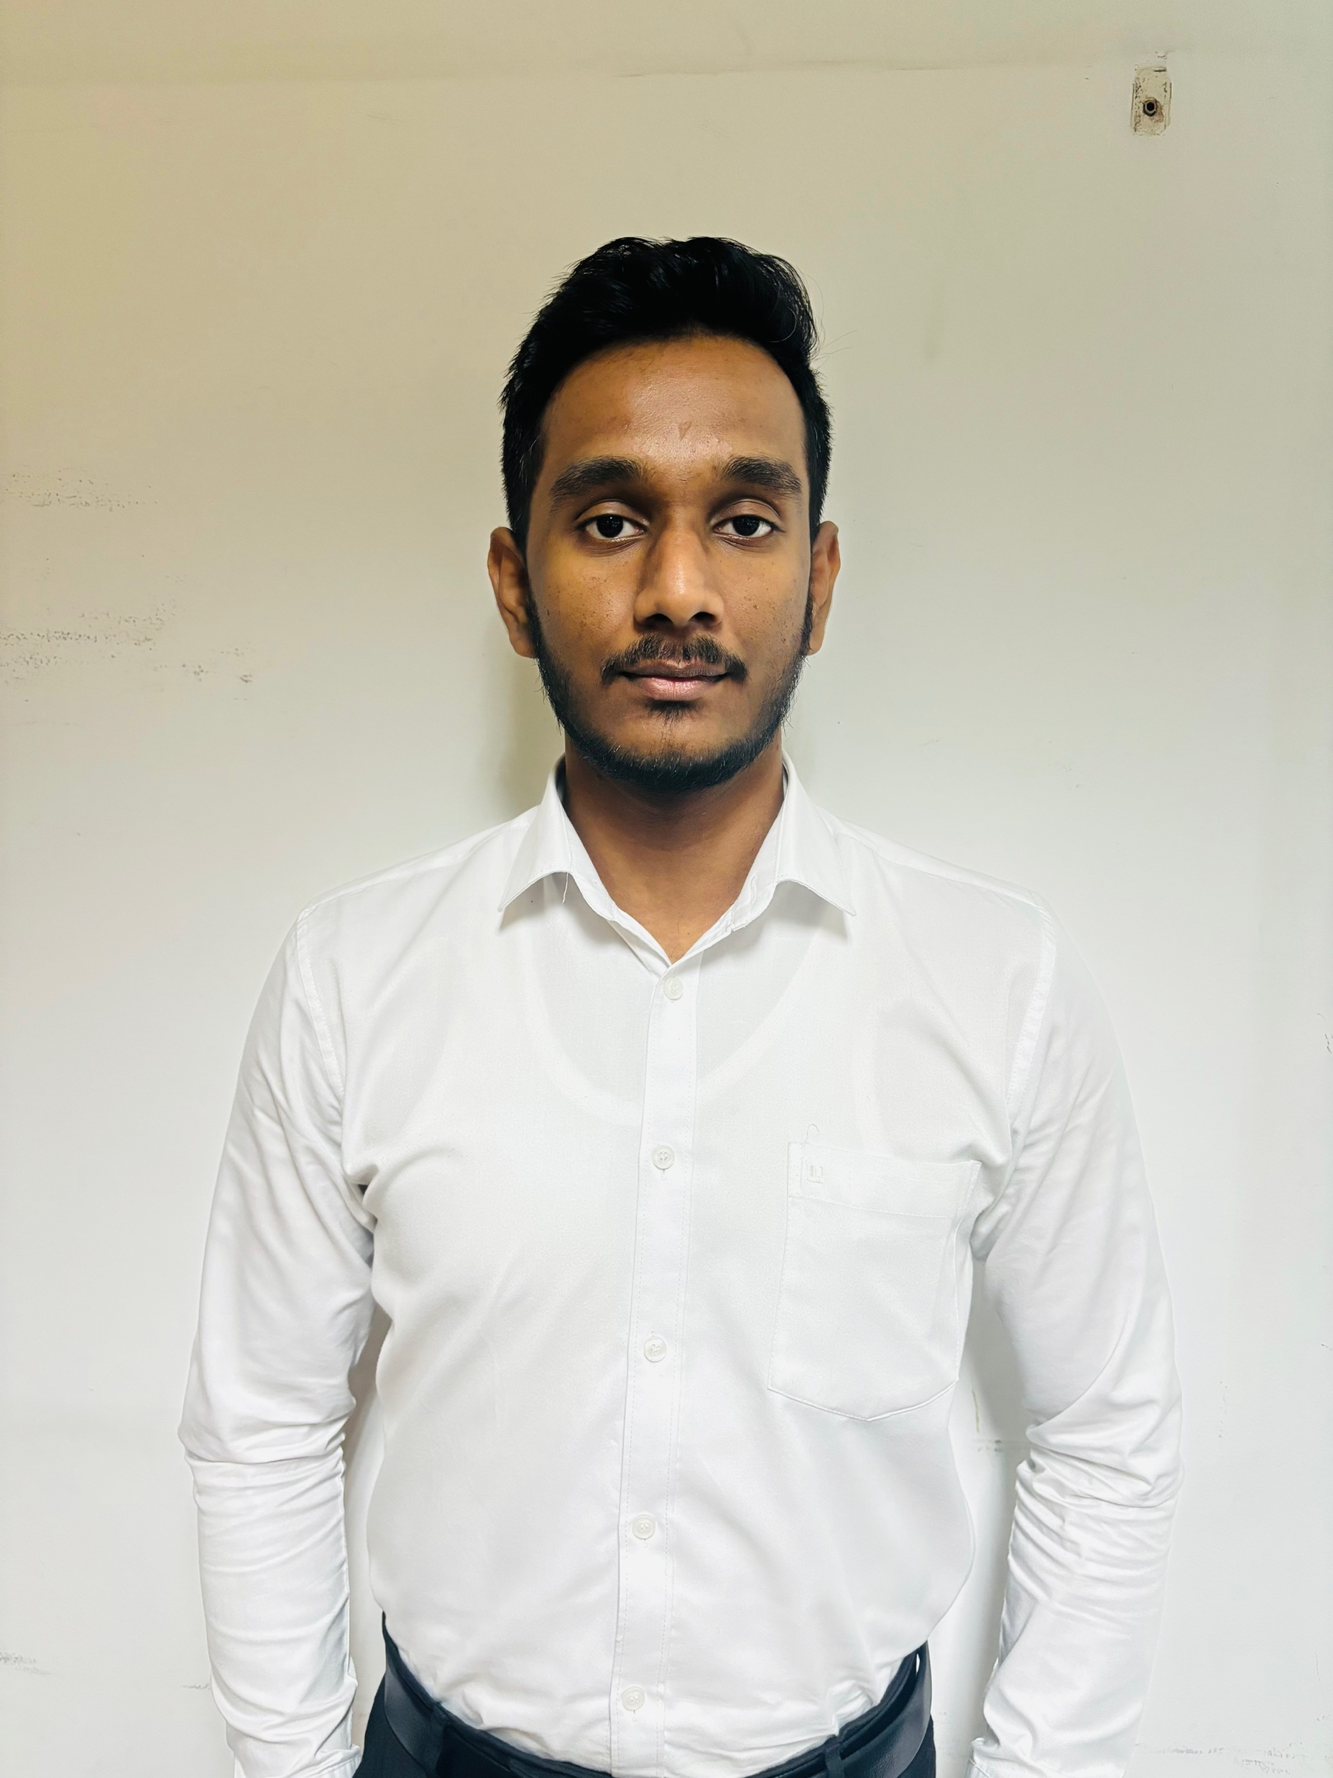
OUR TEAM
Prof. Samantha Thelijjagoda
Supervisor
Dr. Junius Anjana
Co - Supervisor
Dr Asiri Hewamalage
External Supervisor
Silva T.U.D
IT21318320
Madusanka G.K.I
IT21189944
Thalangama T.P
IT21223594
Dissanayake M.G.T.W
IT21319174

Slide 3
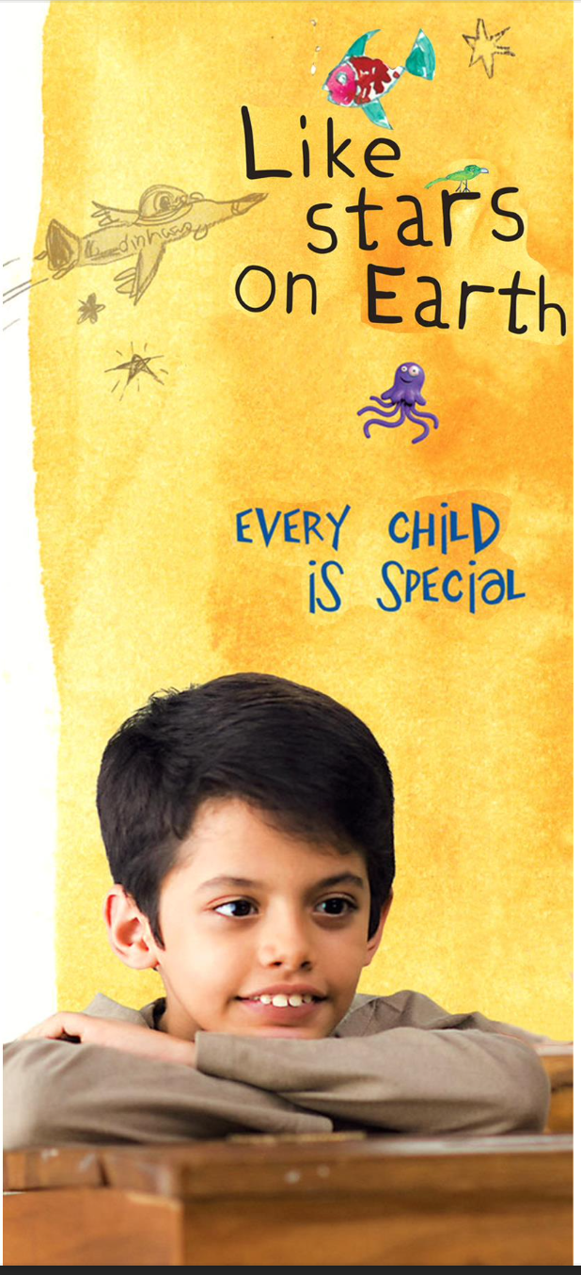
CONTENT
Introduction
2. Research Question
3. Research Gap
4. Proposed System
5. Technologies
6. Domain Expertise and data requirement
7. Individual Components
8. Commercialization Aspects
9. Budget

Slide 4
INTRODUCTION

Slide 5
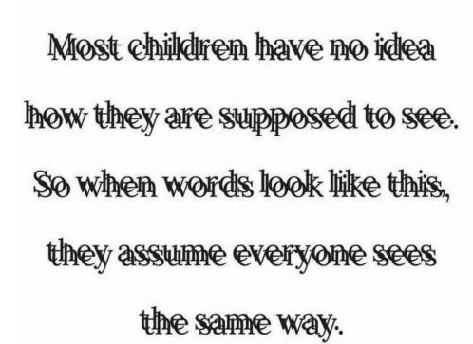

Slide 6
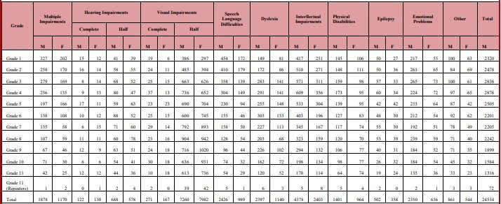
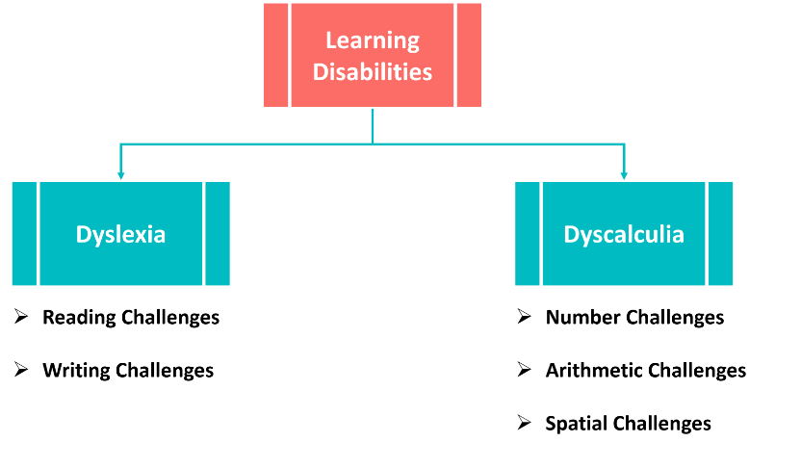
Disability among Students in General Class and Government Schools, Recorded in the Year 2019

Slide 7
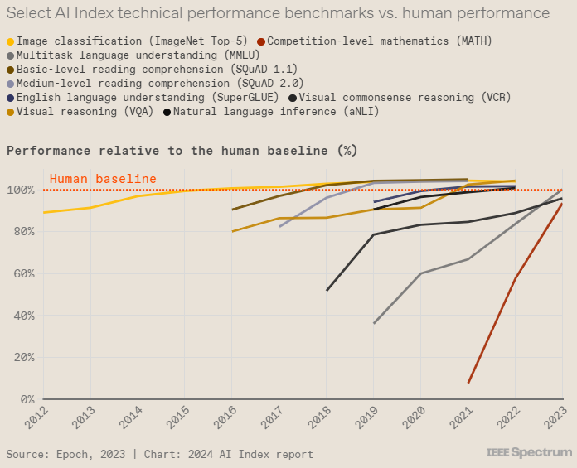
WHY NOT A TECH SOLUTION?
Select AI Index technical performance benchmarks vs. human performance

Slide 8
RESEARCH PROBLEM

Slide 9

Lack of adaptive educational lessons
Need for systems that detect emotional and engagement cues.
Need for personalized and multisensory teaching methods.
Need for audio adjusting features.

Slide 10
OBJECTIVES

Slide 11

Develop a personalized assistive learning platform for children with dyslexia and dyscalculia

Slide 12
Sub Objectives
Enhance reading skills using color variations.
Implement personalized audio output based on speech pace detection.
Improve mathematical skills using the Touch Math approach.
Use real-time emotion detection to adapt tasks dynamically and provide supportive guides.

Slide 13
SYSTEM OVERVIEW DIAGRAM

Slide 14
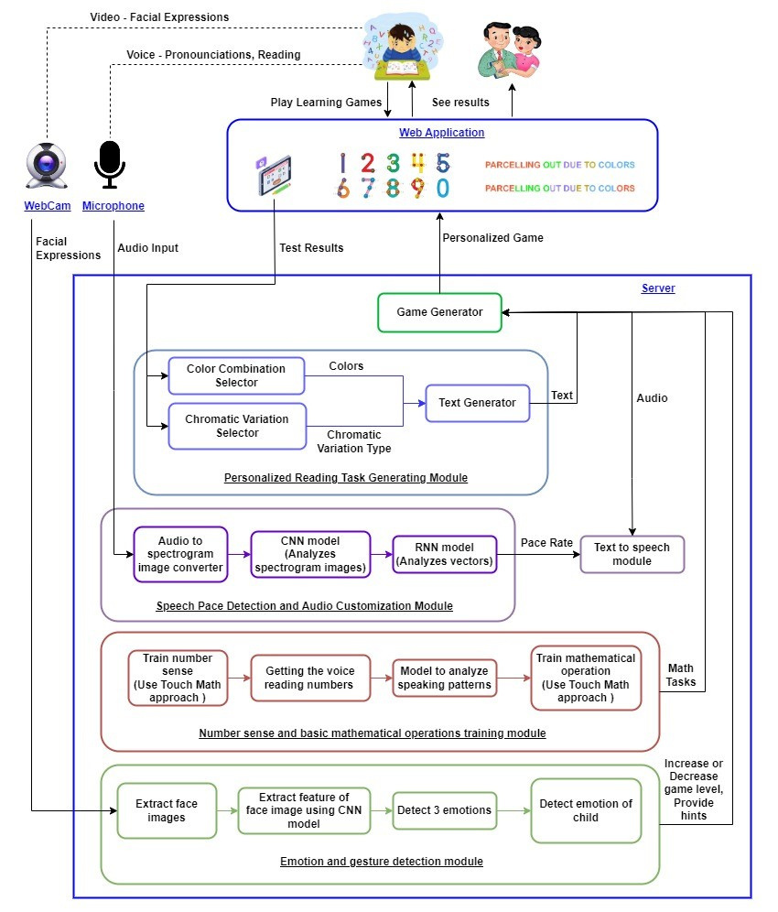

Slide 15
SOFTWARE
DEVELOPMENT PROCESS

Slide 16
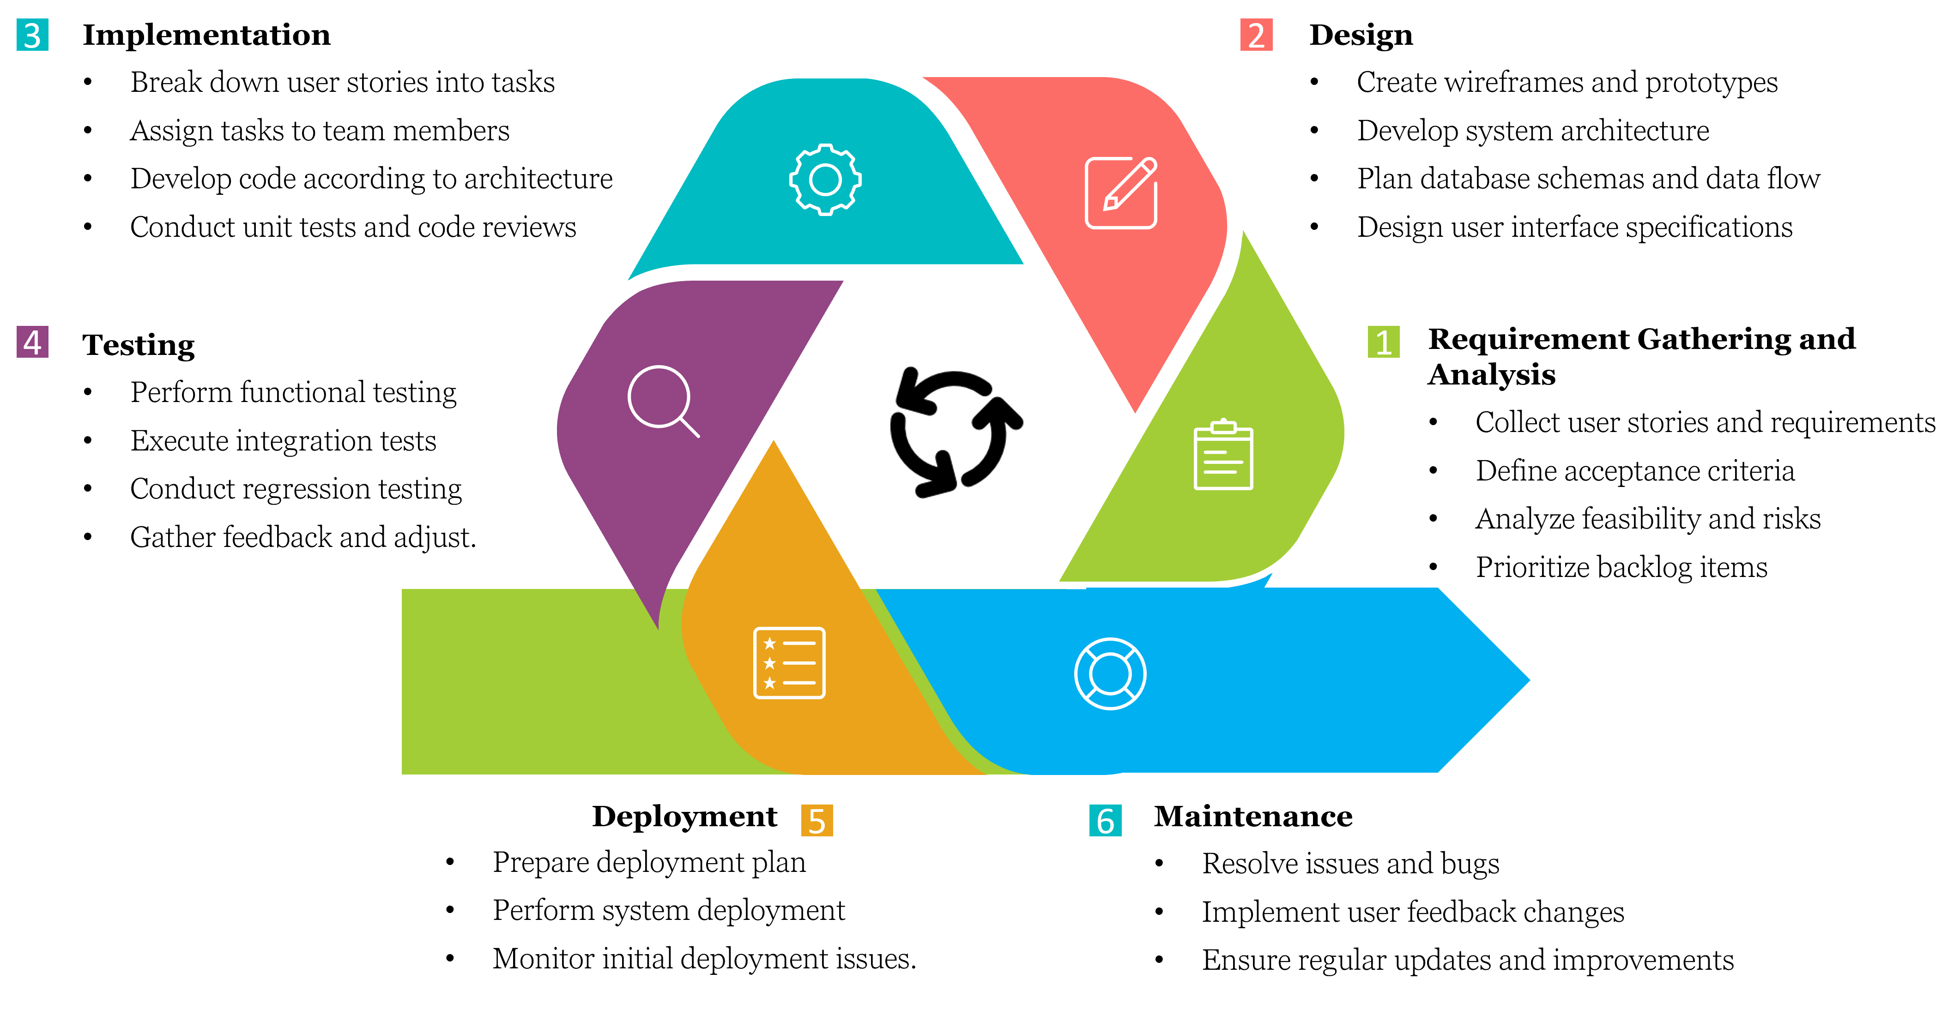
Software Development Life Cycle

Slide 17
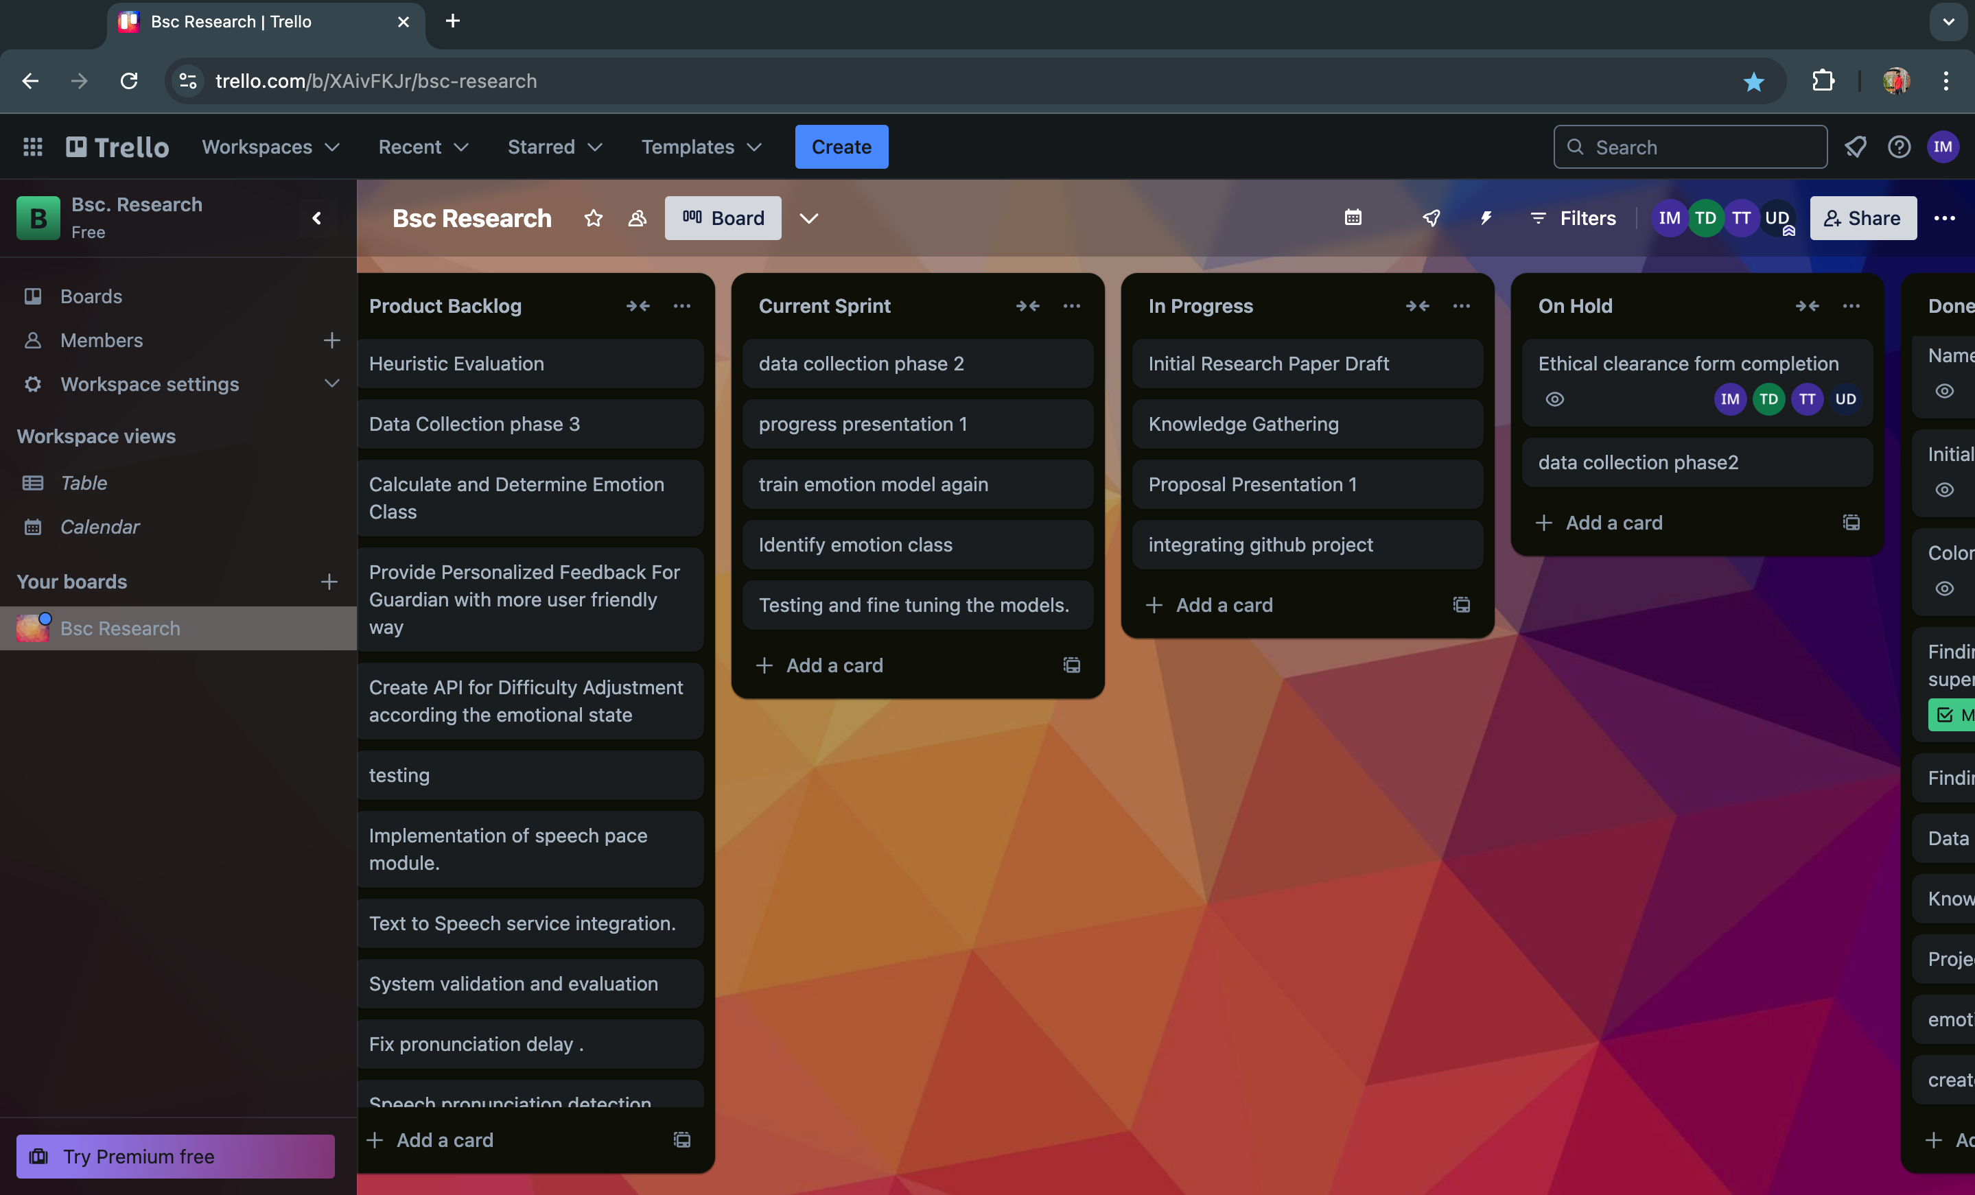

Project Management Dashboard
Figma Prototype

Slide 18
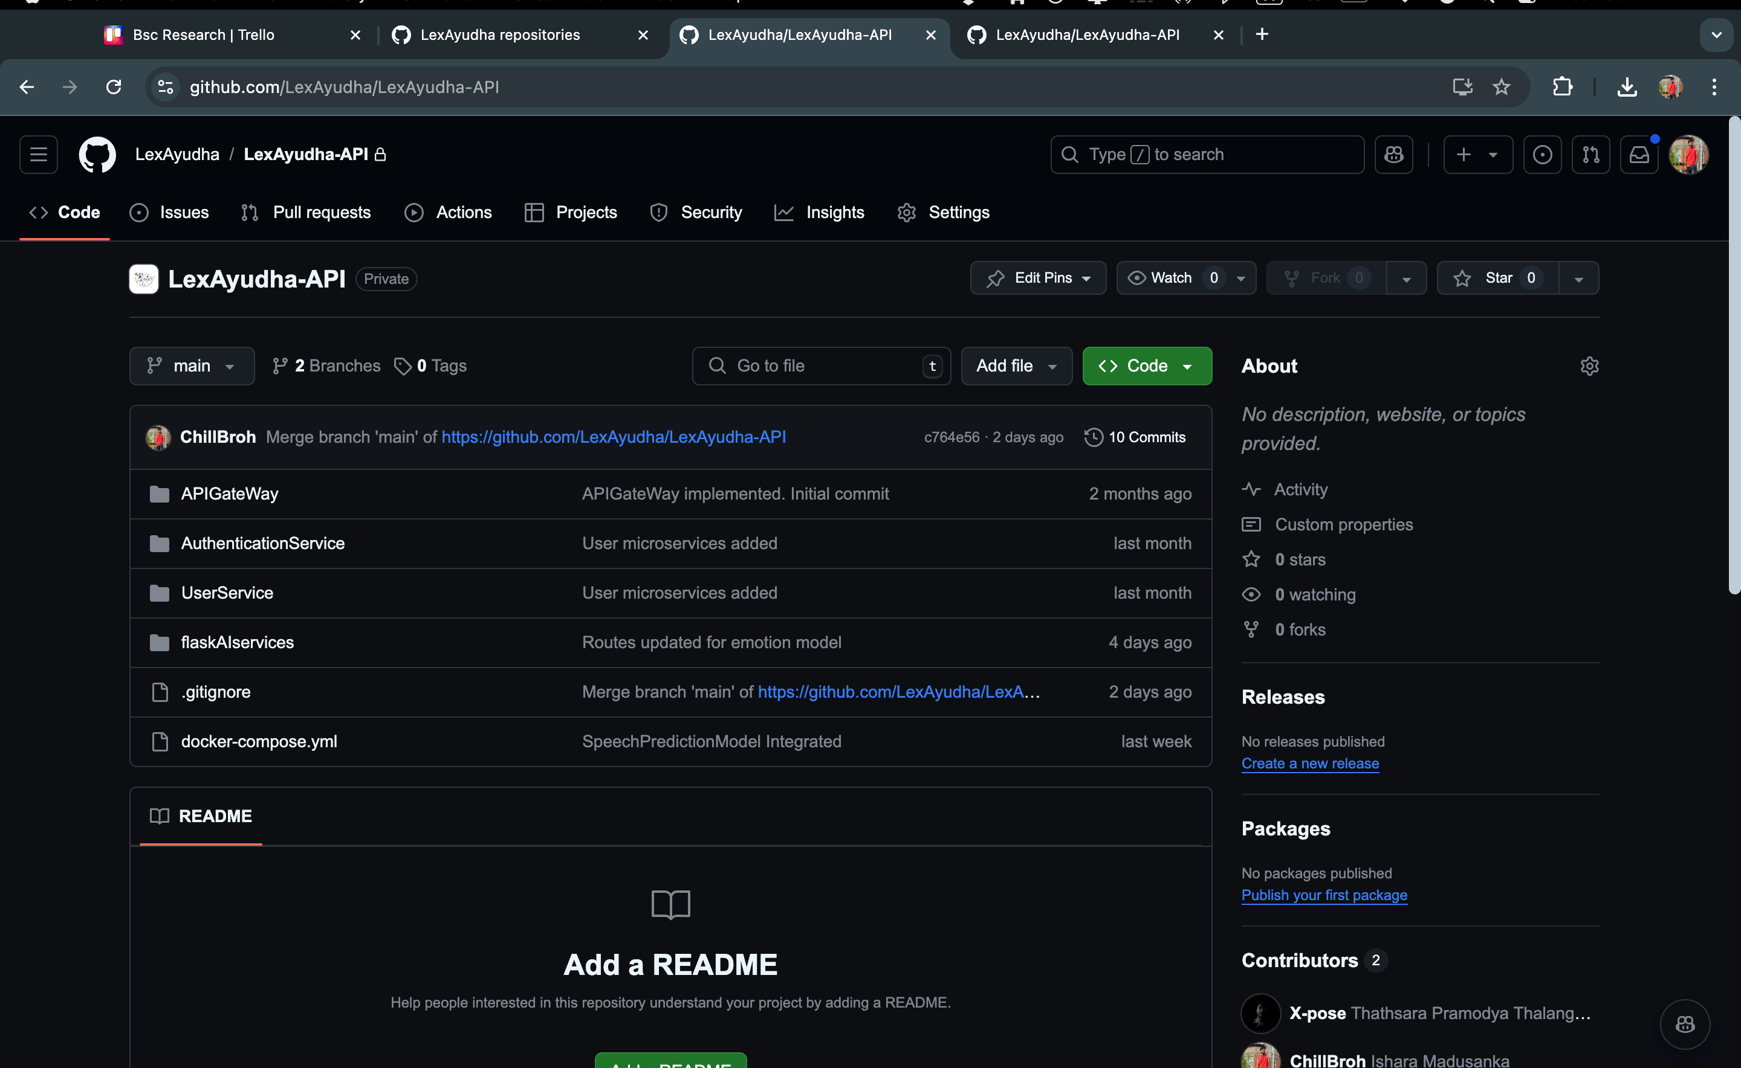
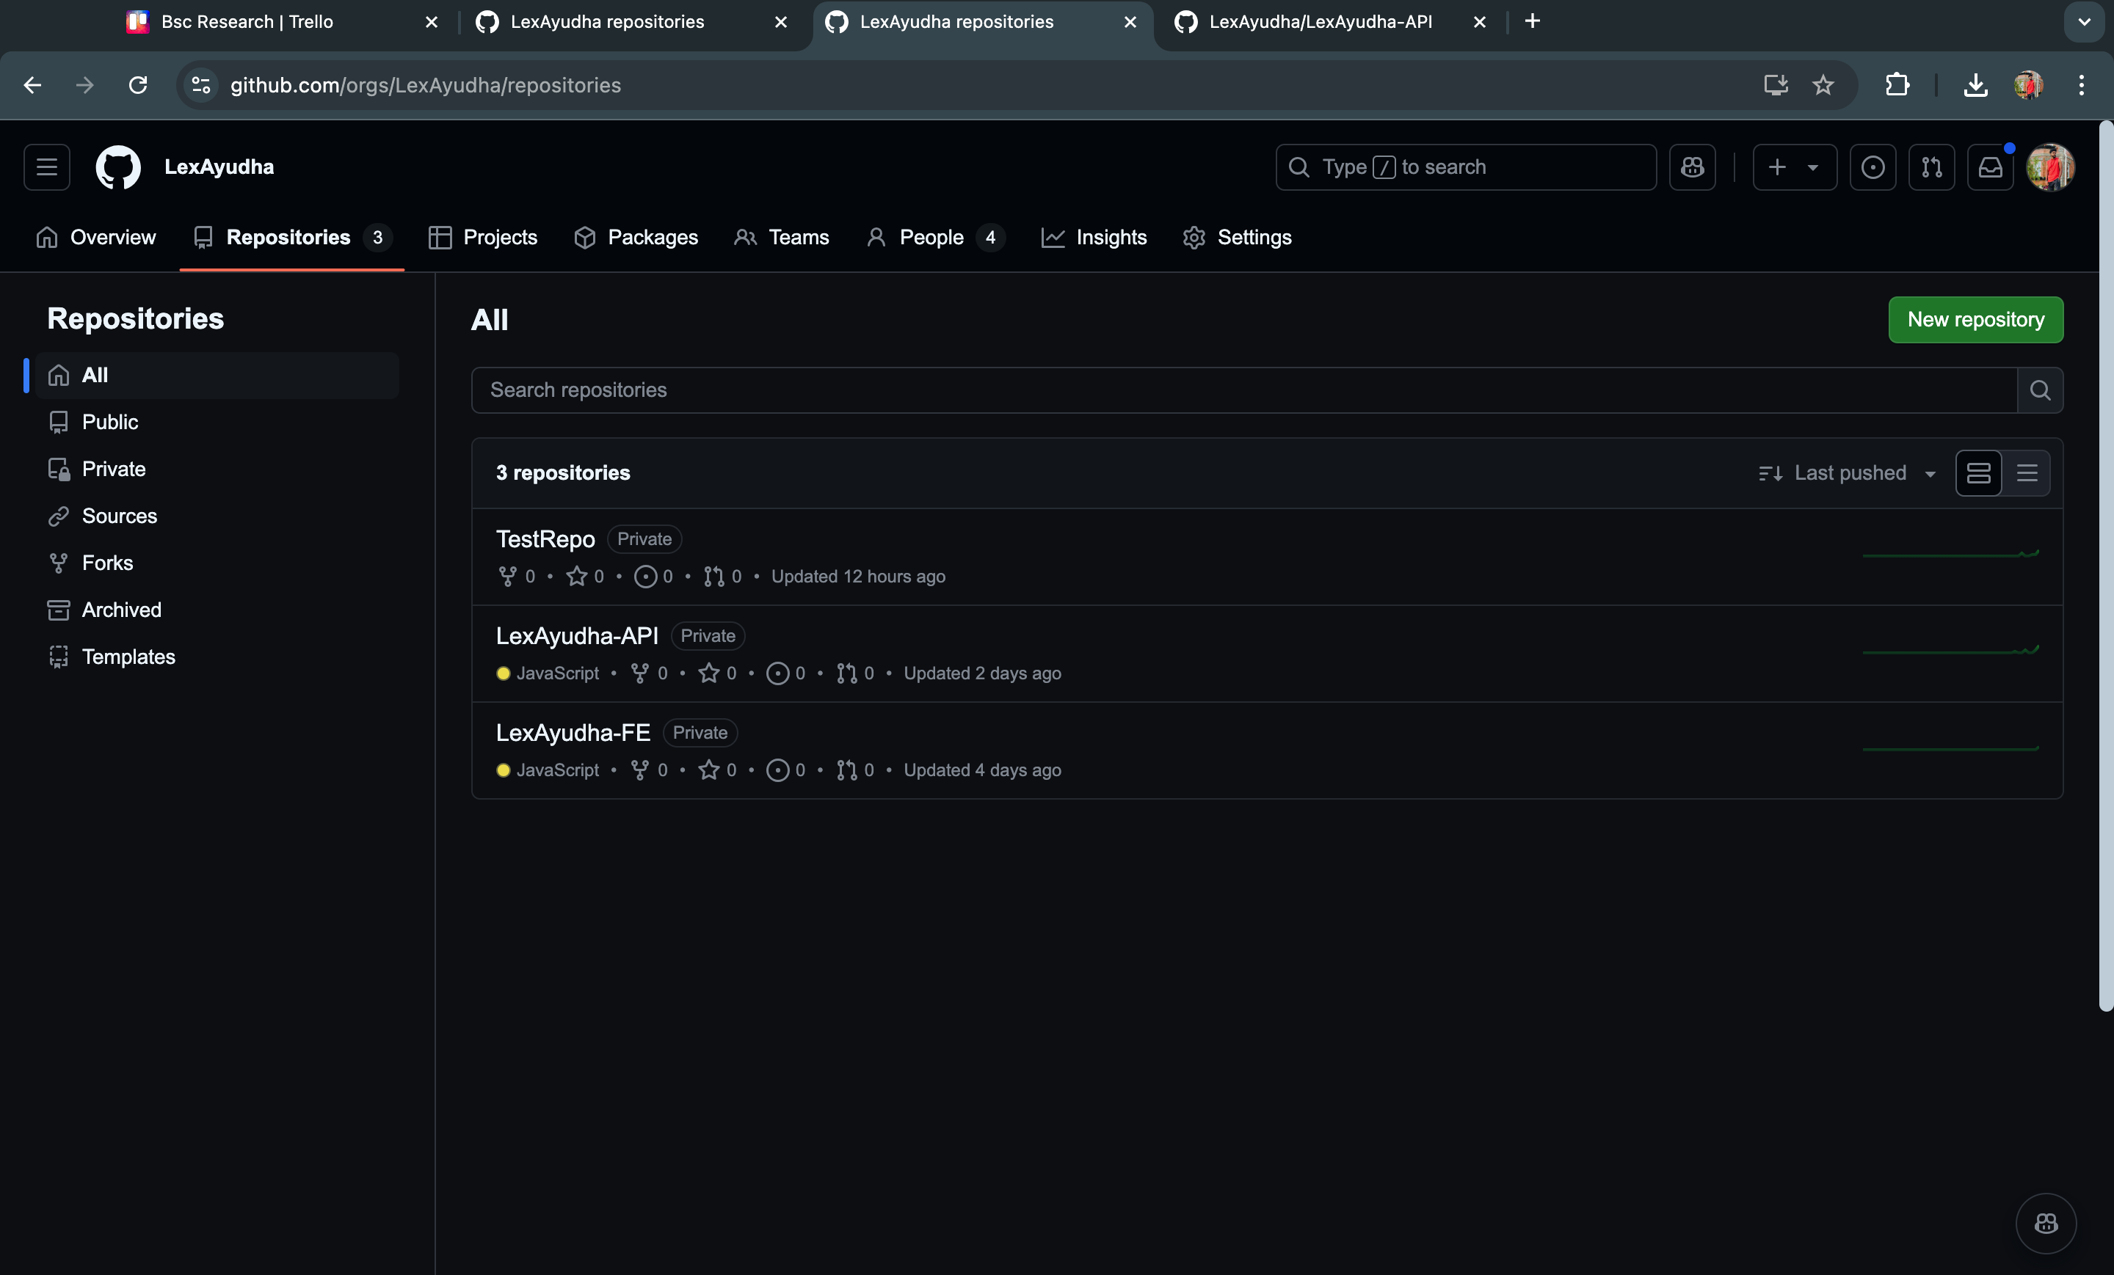
Version Control - Github

Slide 19
TECHNOLOGIES

Slide 20










Frontend
React
Ant Design
Backend
Flask
Node Js
Machine Learning and Deep learning
Python
Jupyter Notebook
TensorFlow
Keras
OpenCV
Keggale
Version Control and Project Management
Github
Trello
Technical Concepts
Machine Learning
Image Processing
Convolutional Neural Network (CNN)
Recurrent Neural Network (RNN)
Containerization
Microservices

Slide 21
INDIVIDUAL COMPONENTS

Slide 22
IT21189944 | Madusanka G.K.I
BSc (Hons) Degree in Information Technology (specialization in Software Engineering)

Slide 23
EMOTION RECOGNITION TO PROVIDE REAL-TIME ADAPTIVE FEEDBACK AND ADJUST ACTIVITY DIFFICULTY LEVEL
IT21189944 | Madusanka G.K.I | 24-25J-233

Slide 24
Research Problem
How do we create
A system that provide
Real time emotion detection to reduce stress level
Support student by dynamically changing the activity level
Personalized Feedback to guardian with child’s emotion status
IT21189944 | Madusanka G.K.I | 24-25J-233
Notes:
Learning disabilities like dyslexia and dyscalculia impact millions of students worldwide, the problem was current solutions only focus on improving their skill without considering their emotional state. So in my problem was how do we create a system to reduce the stress level of the student realtime while they are engaging with the activities and how do we inform their guardins about their improvements and emotional states.

Slide 25
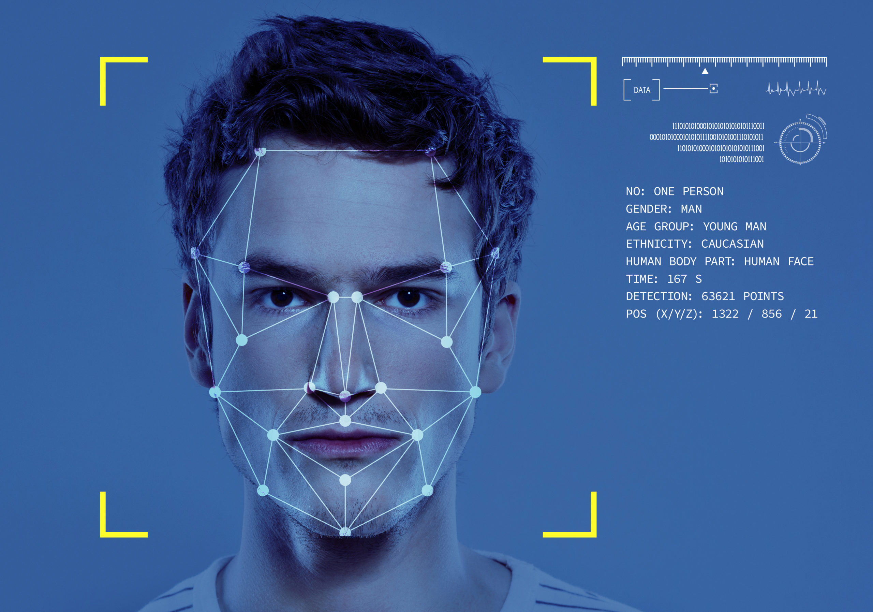
Solution
SPECIFIC OBJECTIVE
Emotion Recognition to provide real-time adaptive feedback and adjust activity difficulty level
SUB OBJECTIVES
Detect emotion and identify the emotion class
Dynamically change acitivity difficulty level
Keep track of student emotional records with relevet activity
Generate Personalized feedback for guardian
IT21189944 | Madusanka G.K.I | 24-25J-233
Notes:
Lexayudha, is a next generation designed to bridge this gap. By combining real-time facial emotion detection with adaptive learning technologies, we dynamically adjust task difficulty based on a student's emotions. Unlike traditional methods, Lexayudha not only focused on learning but also provides personalized emotional feedback reports for guardians, helping them to actively support their children’s educational journey

Slide 26

Objectives Cont.
Key Emotions (5):
1. Happiness
2. Sadness
3. Surprise
4. Anger
5. Neutral
Main Classes (3):
1. Distraction (extended period of neutral, surprise)
2. Frustration (sadness, anger)
3. Engagement (happiness, lower frequency of neutral/sadness
IT21189944 | Madusanka G.K.I | 24-25J-233

Slide 27
Requirements
System Requirements​
Stable internet connection.​
High Definition Web Cam
​
Personal Requirements ​
Consent to capture Video Data.​
Clear & Well lit environment.​
Software Requirements
Web browser with WebCam access.​ ​
Functional Requirements​
User Logs in to system.​
Capture Video Realtime.​
Recognize facial emotions
Dynamically change difficulty level
Generate Personalized feedback report
IT21189944 | Madusanka G.K.I | 24-25J-233

Slide 28
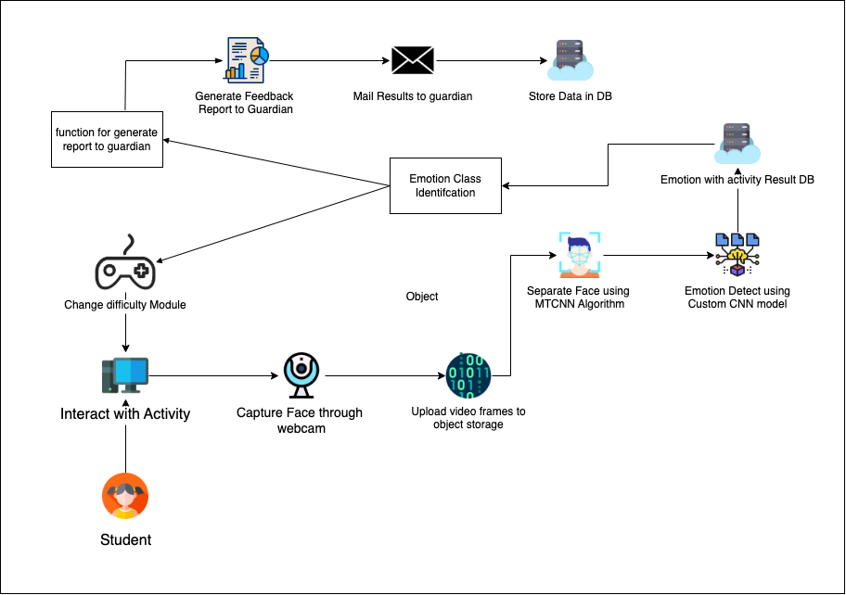
System Diagram
IT21189944 | Madusanka G.K.I | 24-25J-233

Slide 29
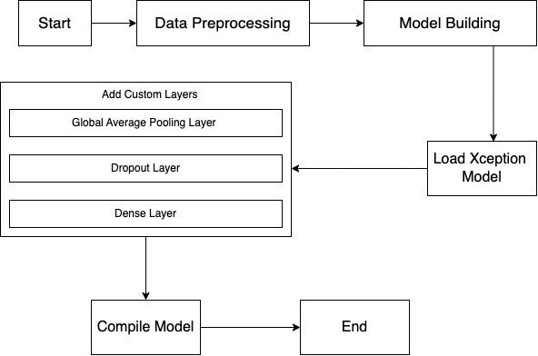
Flow Chart - Model
cross-entropy loss
Adam optimizer
IT21189944 | Madusanka G.K.I | 24-25J-233
Notes:
I start with Data Preprocessing, where the dataset of labeled emotion images is resized to 72x72 pixels and loaded in batches of 128 for efficient processing.
Next is Model Building, where we use the Xception architecture with pretrained ImageNet weights for transfer learning. This foundation is enhanced with layers for pooling, regularization, and a dense output to classify emotions into seven categories.The model is then trained using categorical cross-entropy loss and the Adam optimizer, with metrics like accuracy and precision ensuring performance evaluation

Slide 30
Risk Mitigation
Identified Risks & Mitigation Strategies
​
Poor model training caused by
unbalanced data.
Mitigate by mixing gathered training data
with Kaggle dataset.
​
Guardian Engagement with the
Feedback Report.
Mitigated by Simplify reports with clear visuals (e.g., pie charts)
​
Connect NodeJS User management
with flask backend
Mitigated by adding Microservice architecture
For backend
​
Data Security Concerns
Encrypt all data during transmission and
storage, ensuring compliance with privacy.
IT21223594 | Thalangama T.P. | 24-25J-233

Slide 31
Current progress
Overall completion – 55 % ​
Detect emotion
model implementation – 100%.​
model training – 80 %​
Determine Emotion Class
function to detect emotion class​ for given period of time – 90%
​
Keep track of student emotional records with relevet activity – 100% ​
IT21223594 | Thalangama T.P. | 24-25J-233

Slide 32
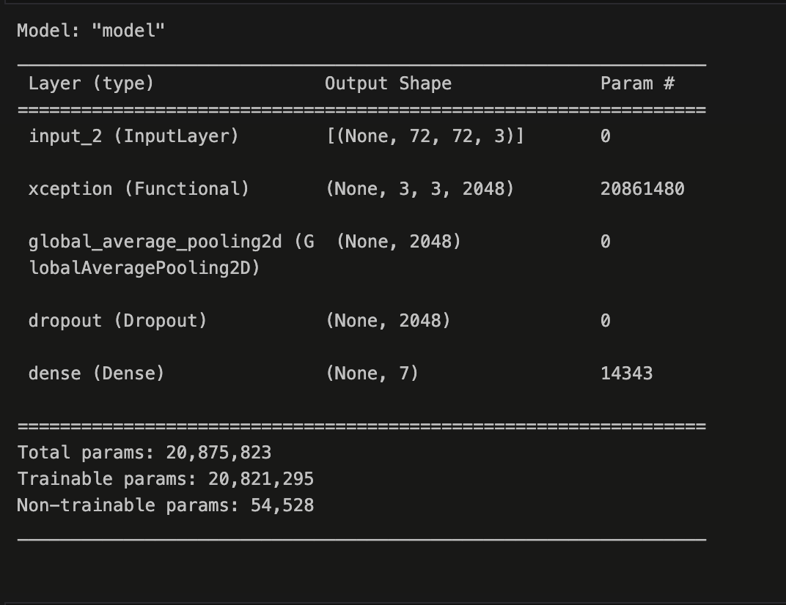
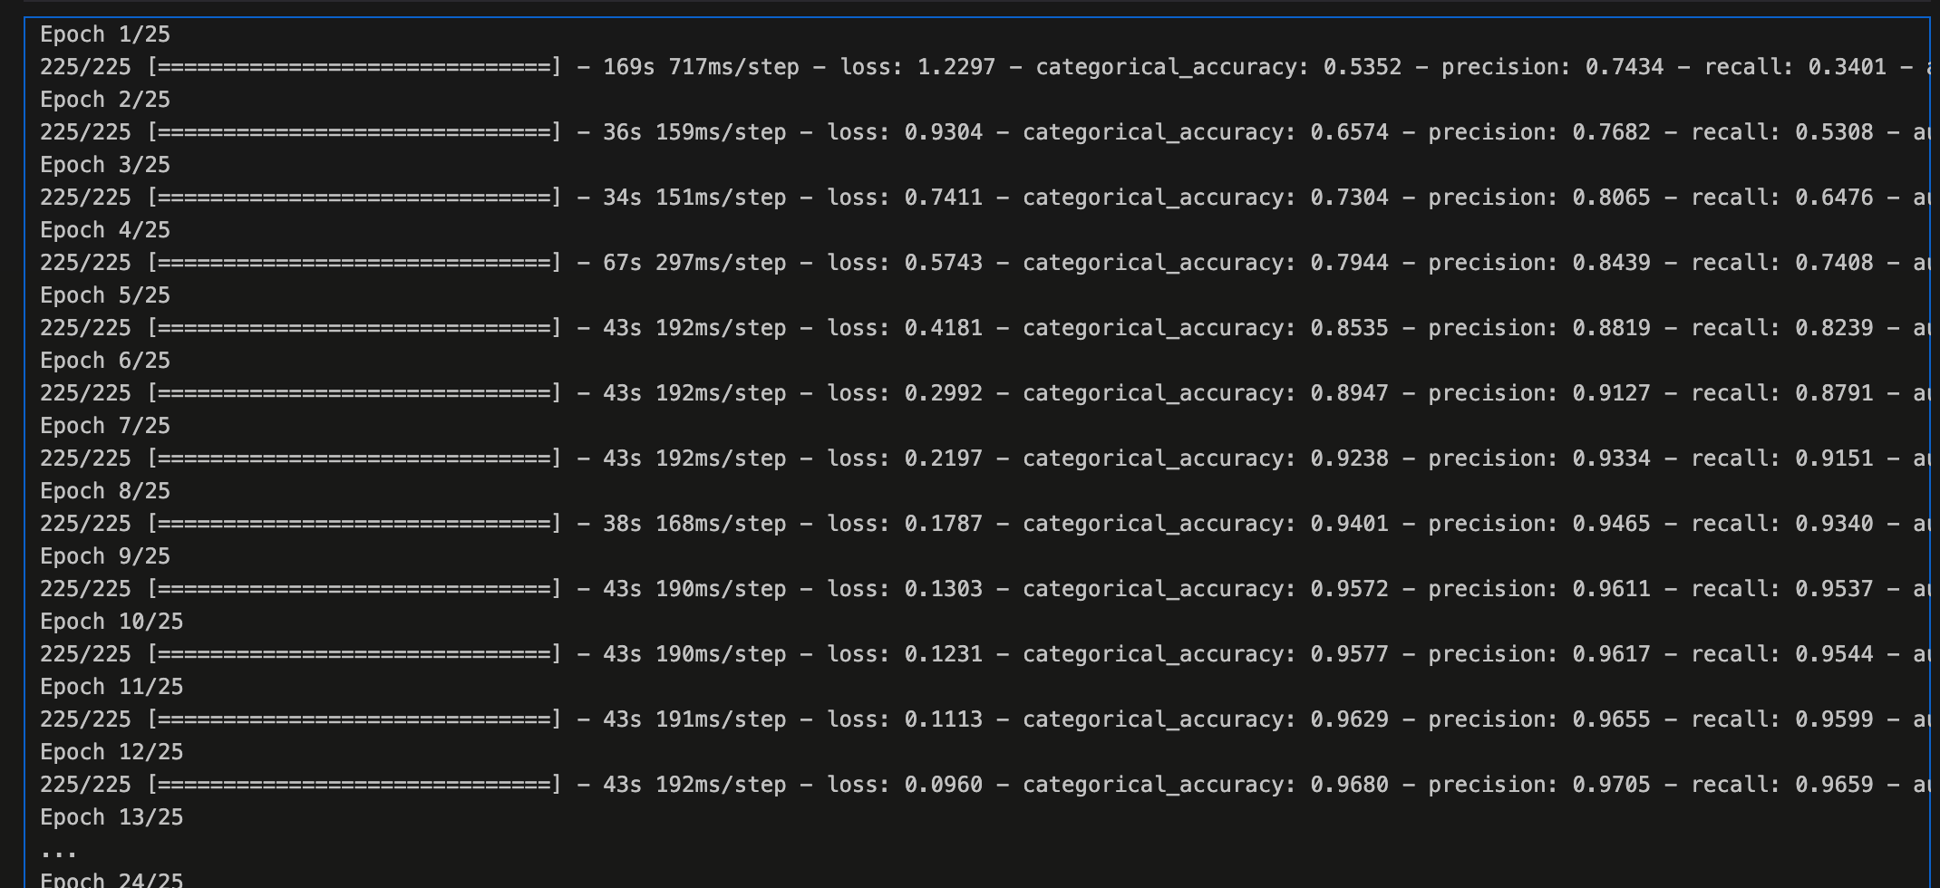
Evidence of Completion
Emotion Model Summary
IT21189944 | Madusanka G.K.I | 24-25J-233

Slide 33
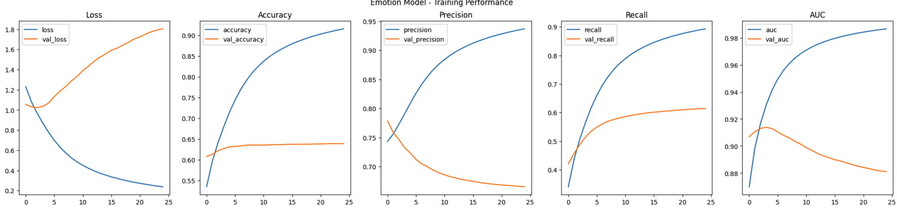
Evidence of Completion
Dataset & Model Training Results
Primary dataset
FER– 2013 (Learn facial expressions from an image ) on Kaggle
Training and validation loss over epochs
IT21189944 | Madusanka G.K.I | 24-25J-233

Slide 34
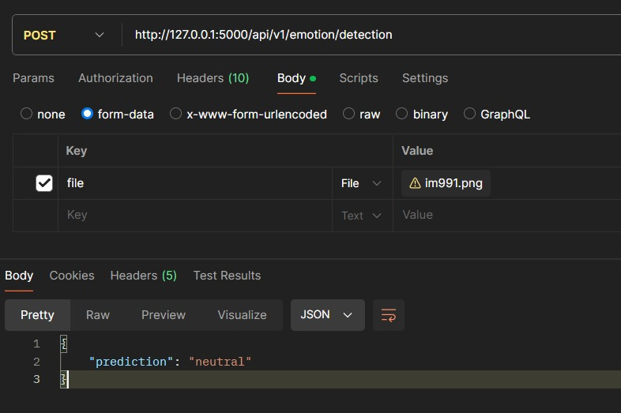
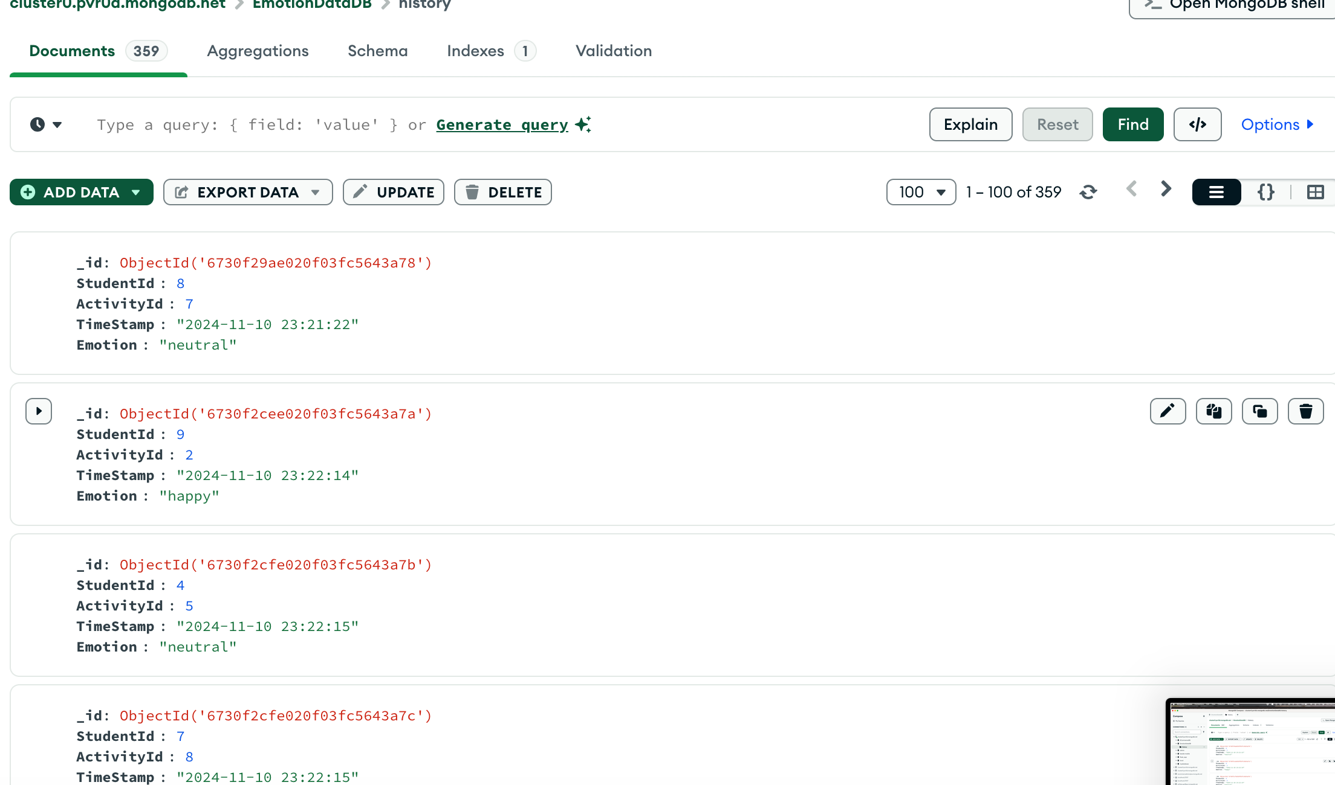
Evidence of Completion
API Request and Face Detected Mongo DB results
IT21189944 | Madusanka G.K.I | 24-25J-233

Slide 35
What to Continue On…
Future Work
Calculate and Determine Emotion Class (10% left)
Provide Personalized Feedback For Guardian with more user friendly way
Create API for Difficulty Adjustment according the emotional state
IT21223594 | Thalangama T.P. | 24-25J-233

Slide 36
IT21319174 |Dissanayake M.G.T.W
BSc (Hons) Degree in Information Technology (specialization in Software Engineering)

Slide 37
TOUCH MATH APPROACH FOR ENHANCING NUMBER SENSE AND MATHEMATICAL OPERATIONS
IT21319174 | Dissanayake M.G.T.W | 24-25J-233

Slide 38
Background
For Dyscalculic adolescents,​
Hard to identify numbers.
Memorable and auditory learning is precious.
IT21319174 | Dissanayake M.G.T.W | 24-25J-233

Slide 39

Research Problem
Lack Analytical Skills
Insufficiency of Traditional Methods
Need Alternative Approches
Need more personalized study process
IT21319174 | Dissanayake M.G.T.W | 24-25J-233

Slide 40
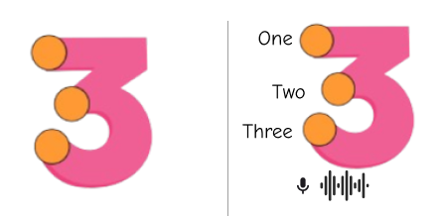
Objectives
NOVELTY OBJECTIVE
Implement teaching numbers with text-to-speech feature.
Integrate voice recognition to analyze number pronunction
OTHER SUB OBJECTIVES
Providing practice sessions, utilizing touch mach approach
Providing mathematical operations utilizing touch mach approach​
Generate performance report
IT21319174 | Dissanayake M.G.T.W | 24-25J-233

Slide 41
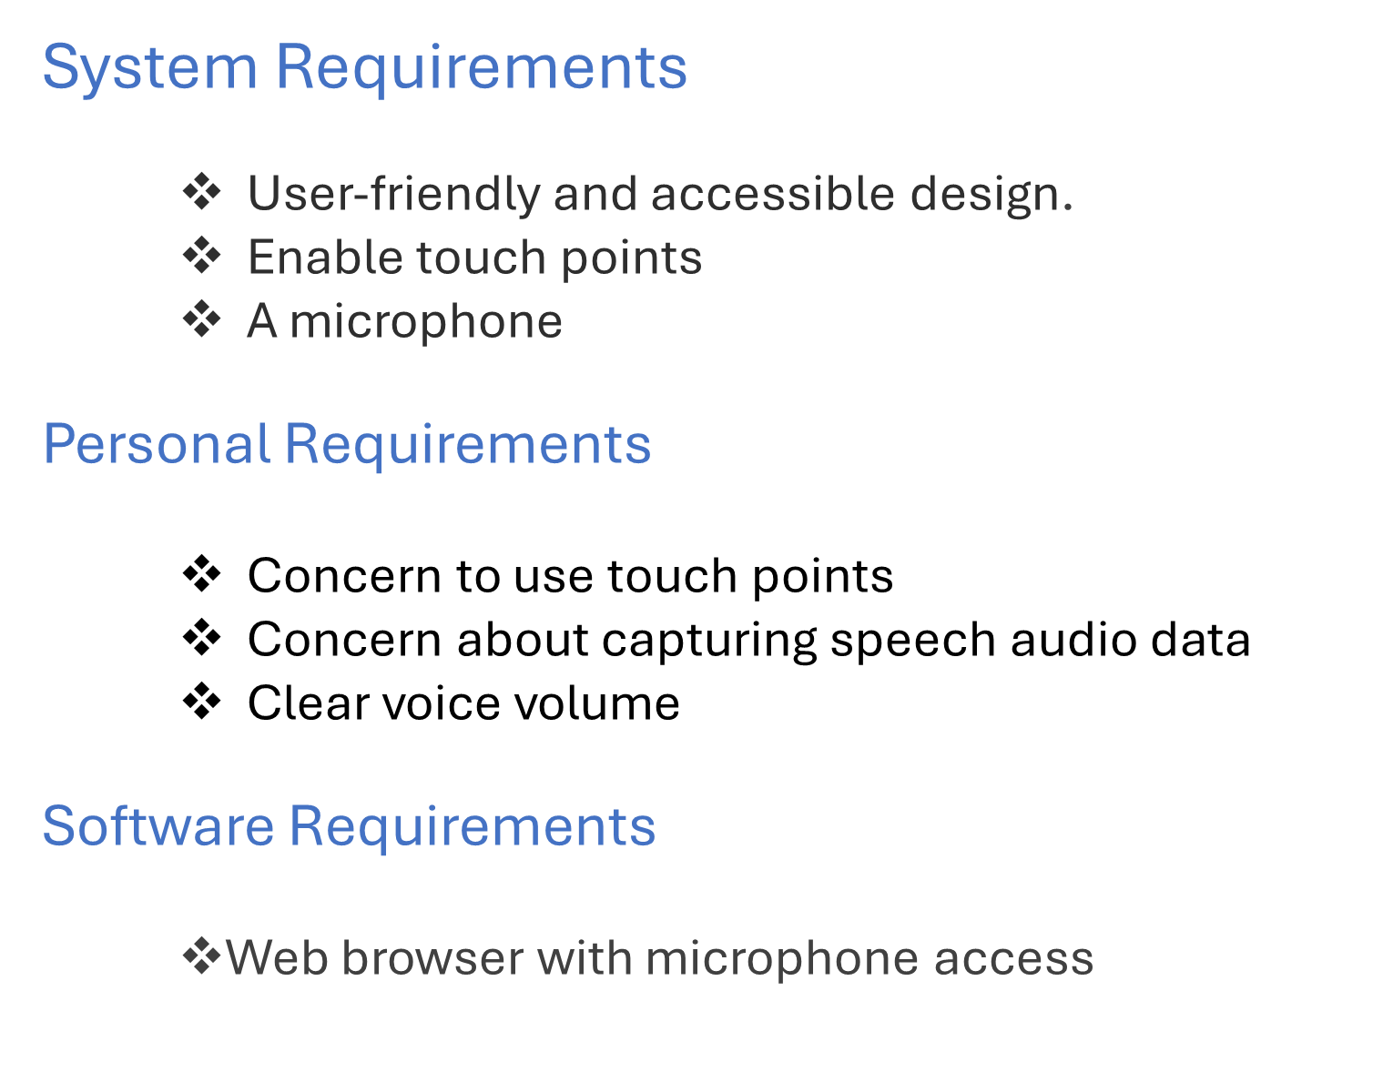
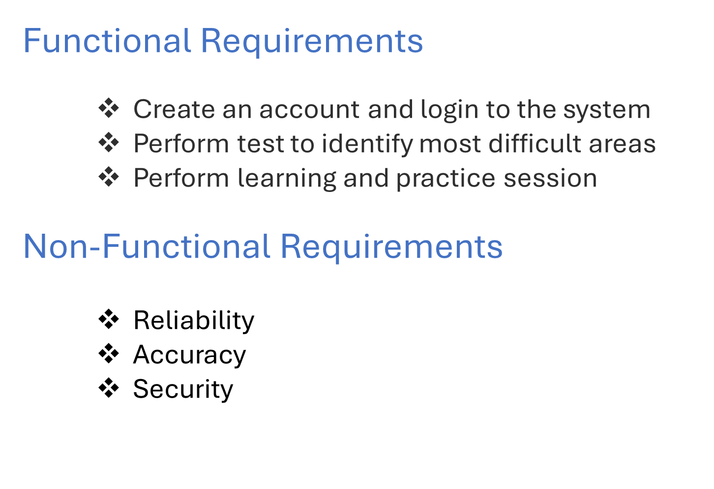
Requirements
IT21319174 | Dissanayake M.G.T.W | 24-25J-233

Slide 42
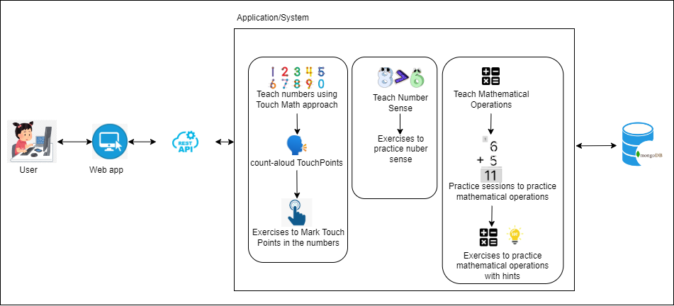
Methodology
IT21319174 | Dissanayake M.G.T.W | 24-25J-233

Slide 43
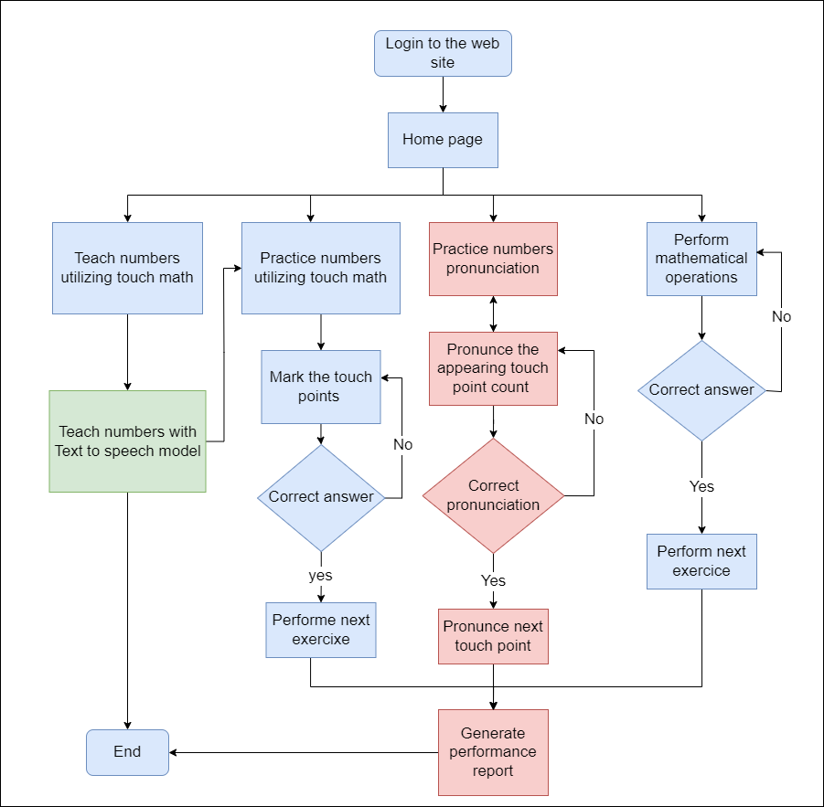
Flow Chart
IT21319174 | Dissanayake M.G.T.W | 24-25J-233

Slide 44
Current Progress
Overall completion – 60% ​
Completions of the component
1. Teaching and Practicing Numbers
Rendering interactive touch points for numbers – 100%
Allowing users to practice touch point interactions for number learning – 100%
2. Text-to-Speech Integration
Implementing using Web Speech API - 80%
3. Practicing Mathematical Operations
Rendering interactive touch points for operations – 100%
Generating random numbers – 100%
IT21319174 | Dissanayake M.G.T.W | 24-25J-233

Slide 45
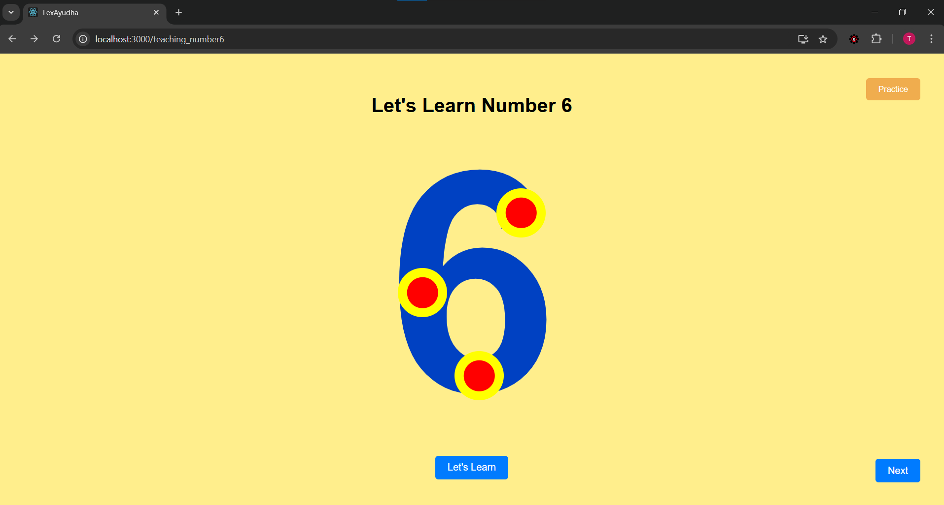
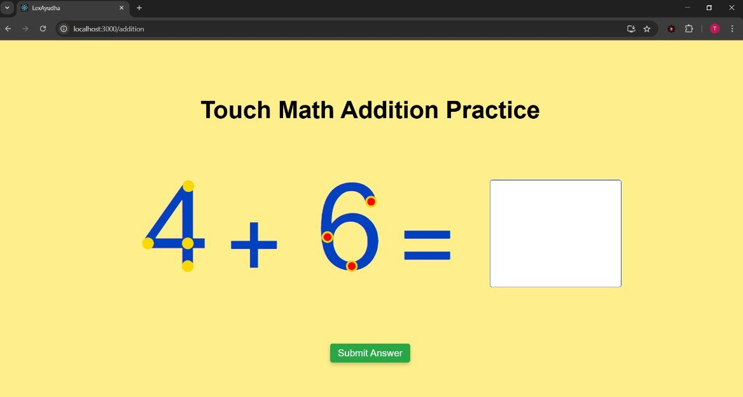
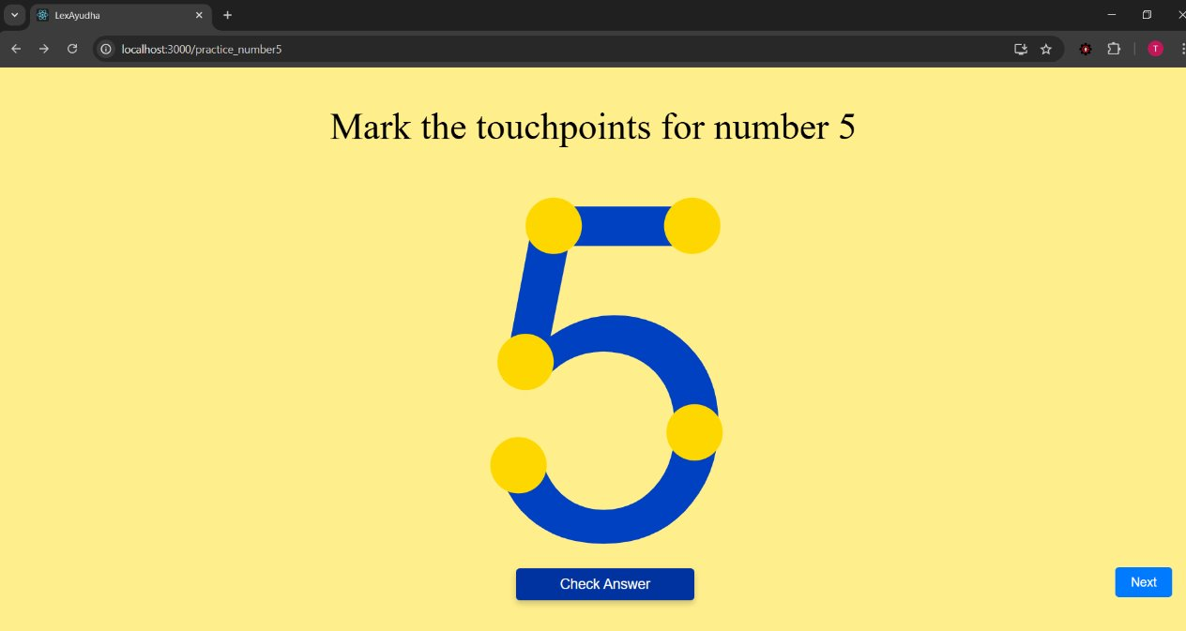
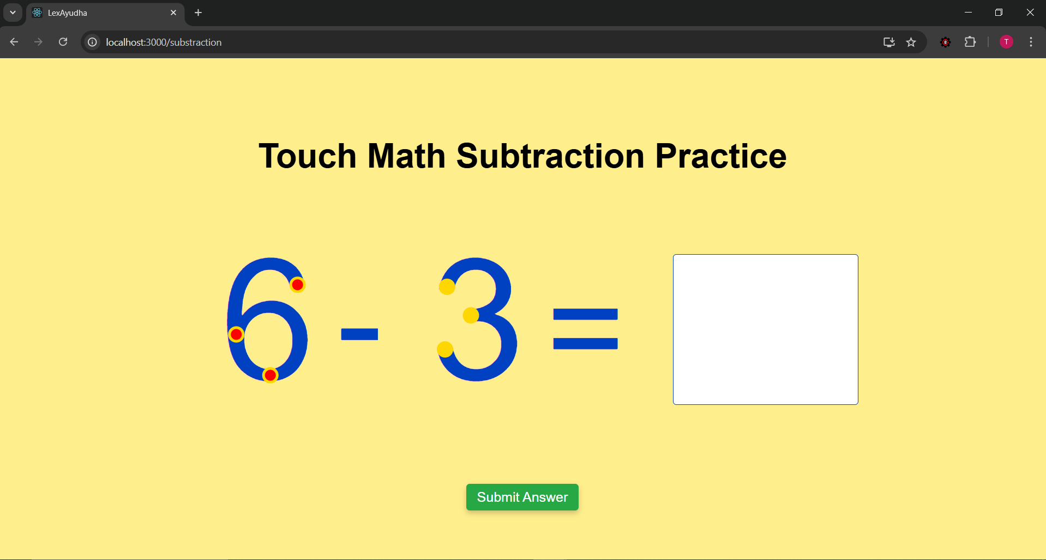
Evidence of Completion
Teaching process
Addition Operations
Practice Sessions
Subtraction Operations
IT21319174 | Dissanayake M.G.T.W | 24-25J-233

Slide 46
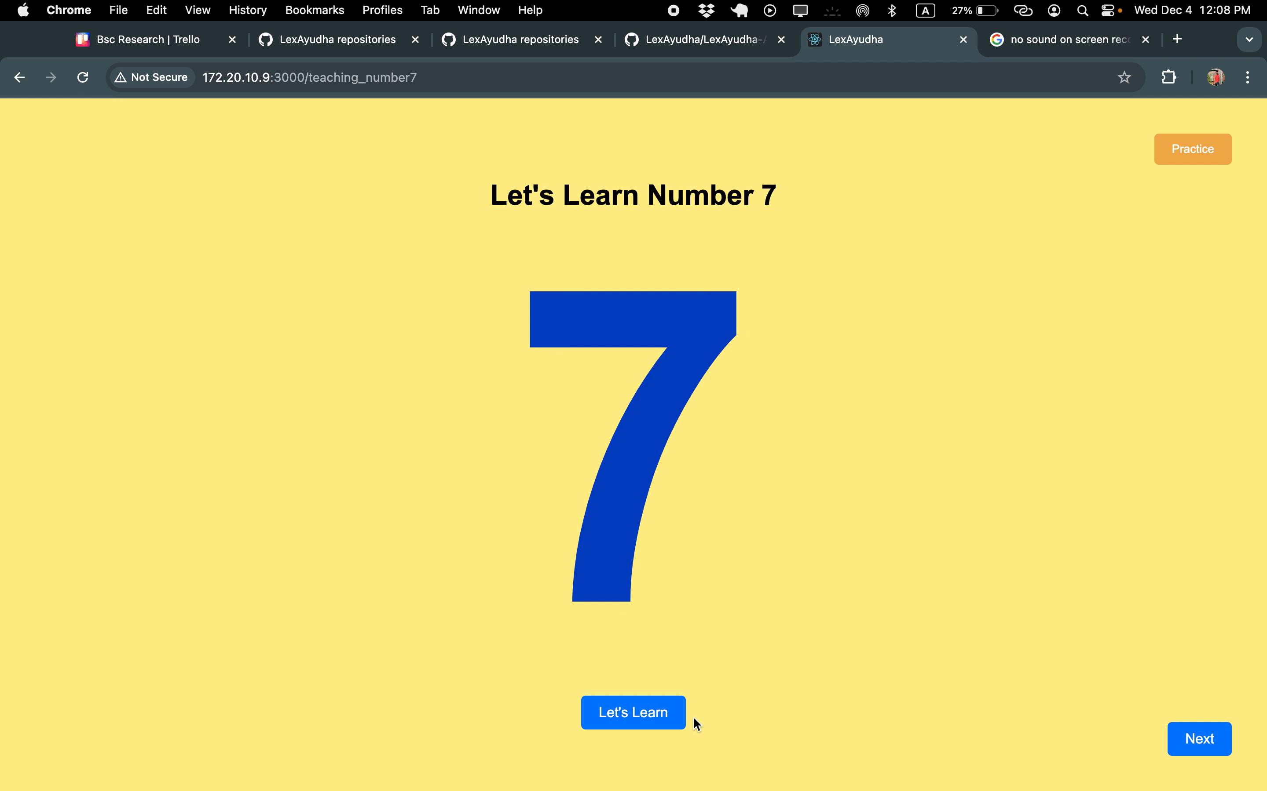
Evidence of Completion
Teaching process
IT21319174 | Dissanayake M.G.T.W | 24-25J-233

Slide 47
Risk Mitigation
Identified Risks & Mitigation Strategies
​
Unexpected behavior in the Text-to-Speech (TTS) Feature
Mitigation can be done by testing it further and finding the root cause and address that issue.
​
Data Privacy and Security
Mitigated by limiting data collection to only what is necessary
IT21319174 | Dissanayake M.G.T.W | 24-25J-233

Slide 48
What to Continue On…
Future Work
Fix pronunciation delay .
Speech pronunciation detection.
Performance report generation.
IT21319174 | Dissanayake M.G.T.W | 24-25J-233

Slide 49
IT21223594 |Thalangama T.P
BSc (Hons) Degree in Information Technology (specialization in Software Engineering)

Slide 50
ENHANCING READABILITY AND
SPEAKING SKILLS IN DYSLEXIC ADOLESCENTS THROUGH
PERSONALIZED SPEECH PACE​
IT21223594 | Thalangama T.P. | 24-25J-233

Slide 51
Overview
Speech Pace and Dyslexia – Why does it matter?
Research Gap
Limits in personalized speech pace in existing methods
Research Problem
How can we leverage the latest technology trends
How can we exceed and overcome current limitations
Solution with novelty
Speech Pace Detection using Deep Learning.
IT21223594 | Thalangama T.P. | 24-25J-233

Slide 52

Objectives
SPECIFIC OBJECTIVE
Develop AI speech pace system for personalized learning
SUB OBJECTIVES
Detect speech pace through voice data.
Analyzing voice features.
Integrating detected speech pace with text to speech(TTS) model
System evaluation and validation.
IT21223594 | Thalangama T.P. | 24-25J-233

Slide 53
Requirements
System Requirements​
Stable internet connection.​
A microphone.​
Personal Requirements ​
Consent to capture speech audio data.​
Clear & sufficient speech volume.​
Software Requirements
Web browser with microphone access.​ ​
Functional Requirements​
Automated speech pace detection.​
Customized speech pace for each individual.​
Non-functional Requirements ​
Speech pace accuracy.​
Reliability & availability .​
IT21223594 | Thalangama T.P. | 24-25J-233

Slide 54


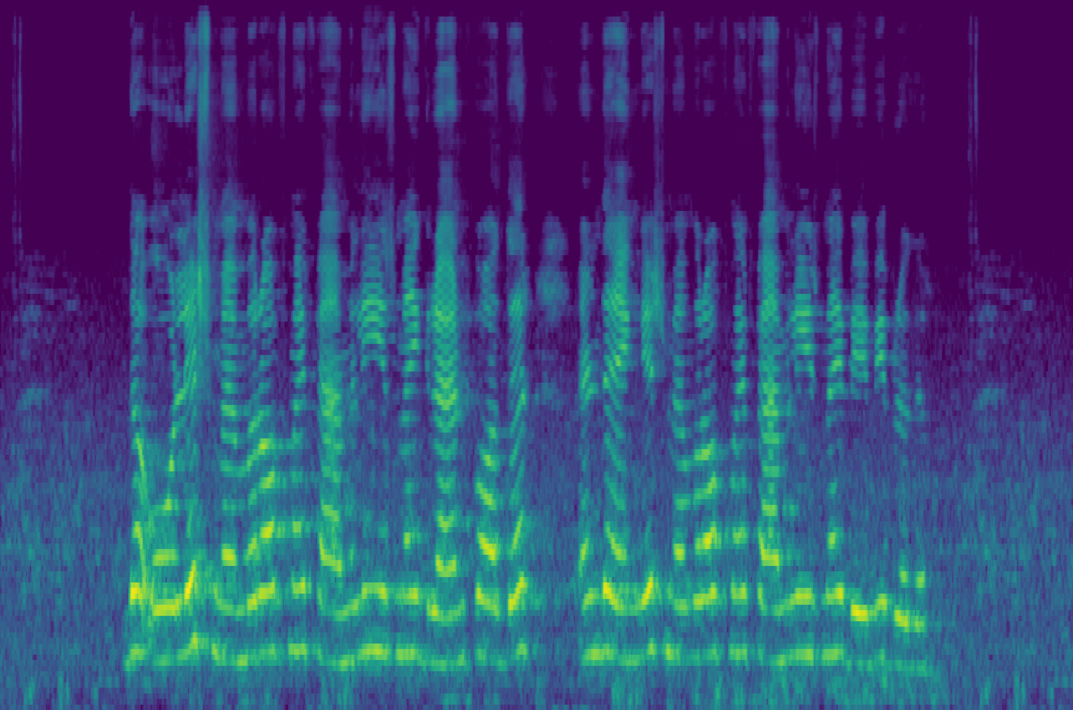
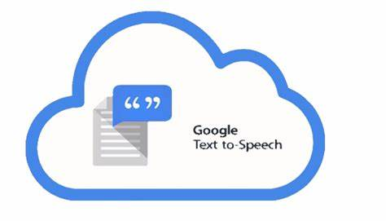
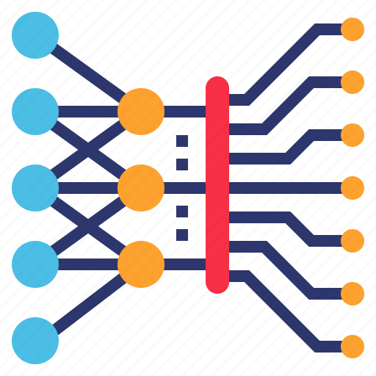

Methodology
server
Captured voice audio
Personalized speech
Text to Speech service
Hybrid CNN-RNN model
Saving speech pace
Speech pace module
Predicted speech rate
Database
IT21223594 | Thalangama T.P. | 24-25J-233

Slide 55
Model Architecture
CNN branch – VGG16
Multi-layer Feature Combination
Image Input
Convolutional Layers
Concatenate Feature
Feature Extraction layers
Final prediction layer
CNN Reduction Layer
Combine Layer 1
Combine Layer 2
Predicted speech pace
RNN branch –Wav2Vec 2.0
Audio Input
Combine Layer 3
Unfrozen Layers
Wav2Vec Reduction Layer
IT21223594 | Thalangama T.P. | 24-25J-233

Slide 56
Current progress
Overall completion – 60% ​
Completion of objectives​
Detect speech pace.
Hybrid model implementation – 100%.​
​
​
2. Analyzing voice features.
Hybrid model training – 75%.
​
​
3. Integrating detected speech pace with text to speech(TTS) service.
Hybrid model integration – 100%.​
TTS service integration – to be done.
​
4. System evaluation and validation.
To be done.​
IT21223594 | Thalangama T.P. | 24-25J-233

Slide 57
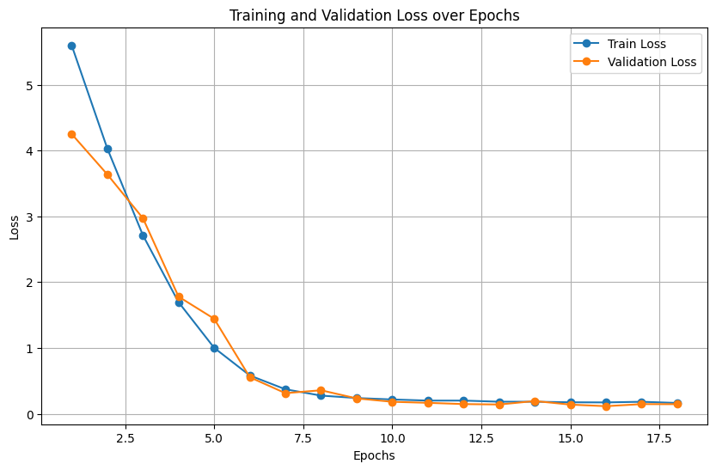
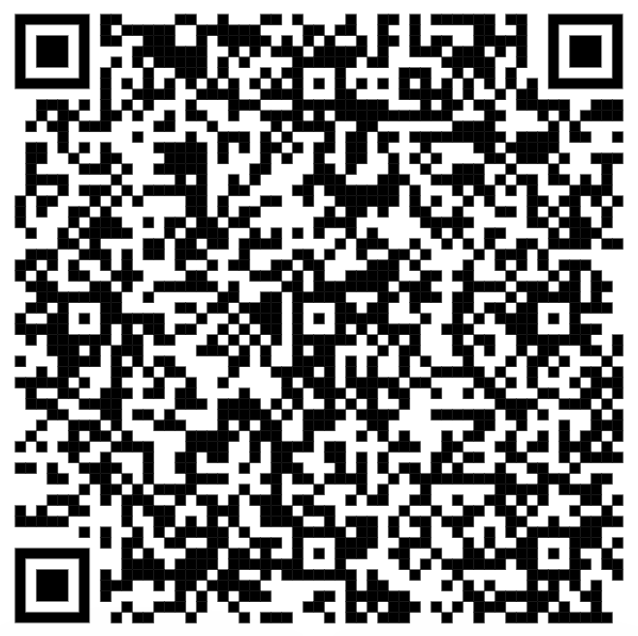
Evidence of Completion
Model Training Results
Dataset
Non-Native Children English Speech (NNCES) Corpus on Kaggle
Visit Dataset
IT21223594 | Thalangama T.P. | 24-25J-233

Slide 58
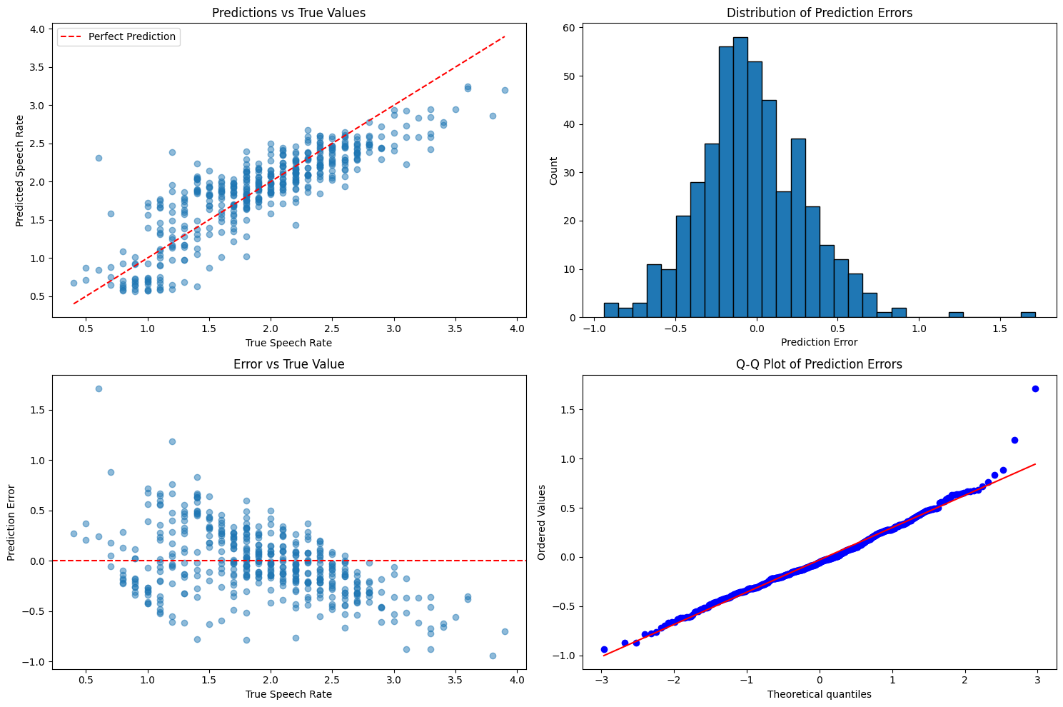
Evidence of Completion
Model Performance Metrics
IT21223594 | Thalangama T.P. | 24-25J-233

Slide 59
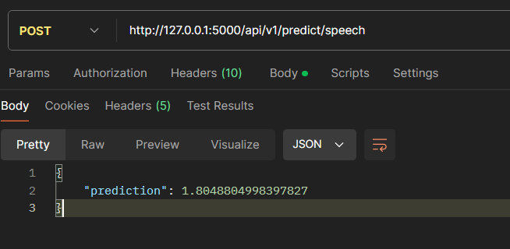
Evidence of Completion
Model Integration Testing – API Testing
IT21223594 | Thalangama T.P. | 24-25J-233

Slide 60
Risk Mitigation
Identified Risks & Mitigation Strategies
​
Poor model training caused by
unbalanced data.
Mitigated by mixing gathered training data
with Kaggle dataset.
​
Model Overfitting
Mitigated by adding regularization methods.
​
Data Storage & Privacy Concerns
Mitigated by immediately deleting data after
the prediction is completed.
IT21223594 | Thalangama T.P. | 24-25J-233

Slide 61
What to Continue On…
Future Work
Implementation of speech pace module.
Text to Speech service integration.
System validation and evaluation.
IT21223594 | Thalangama T.P. | 24-25J-233

Slide 62
IT21318320 | Silva T.U.D
BSc (Hons) Degree in Information Technology (specialization in Software Engineering)

Slide 63
Teaching based on
Chromatic Variations
For Dyslexics
to improve Reading Skills
IT21318320 | Silva T.U.D | 24-25J-233

Slide 64
Overview
Dyslexia – Most common Learning Disability
Reading – Most common symptom
Existing Solutions
Nessy – User friendly mobile app
ClarroSpeak – Text highlighting enabled app
Research Gap
Why not a scientifically proven method?
Is all the same?
Solution with novelty
LexaAyudha
Chromatic Variation, Personalization, Web Application
IT21318320 | Silva T.U.D | 24-25J-233

Slide 65
Overview
Research Problem
Automating the generation of meaningful sentences with personalization capabilities.
Identifying suitable chromatic variation type complexity level.
Objectives
Identify the appropriate chromatic variation types and colors.
Sample test to identify the efficient color combinations.
Sample test to identify the most efficient chromatic variation type.
Provide a personalized activity plan.
Test to check the reading skills to customize the complexity levels of the tasks.
Create personalized reading task plans.
IT21318320 | Silva T.U.D | 24-25J-233

Slide 66
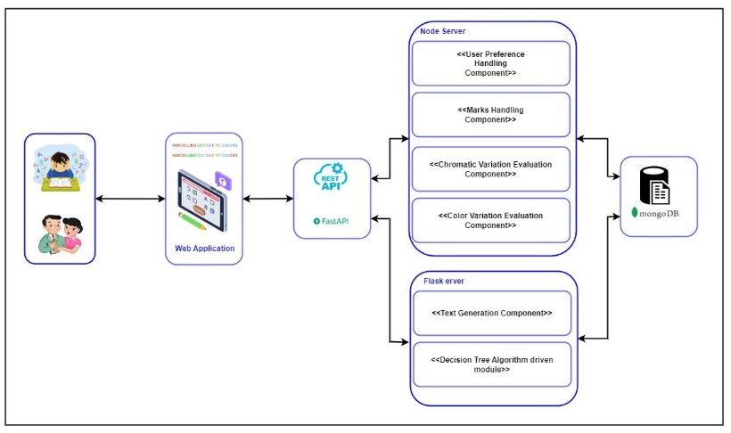
Methodology
IT21318320 | Silva T.U.D | 24-25J-233

Slide 67
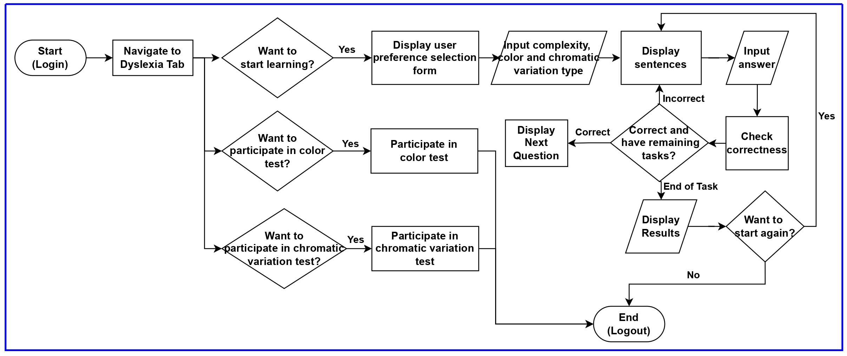
System Flow
IT21318320 | Silva T.U.D | 24-25J-233

Slide 68
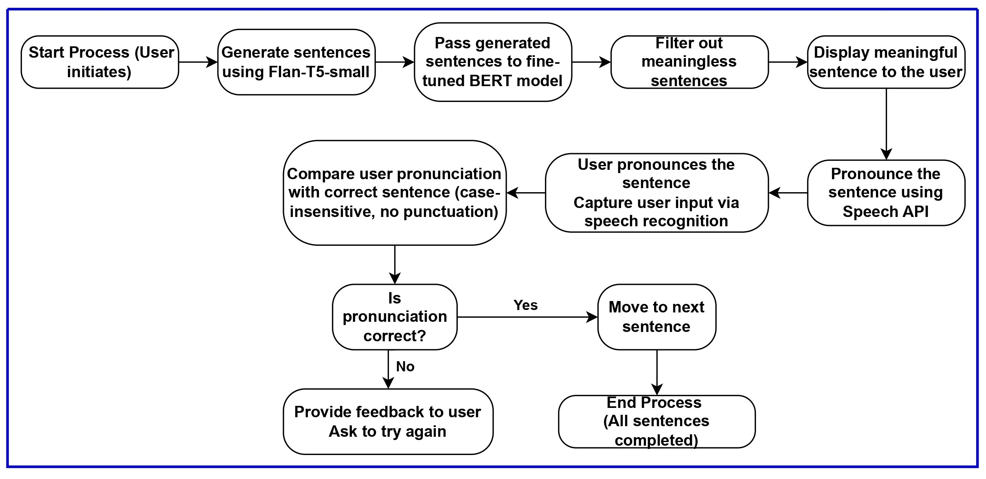
Progress
Overall completion – 56% ​​
IT21318320 | Silva T.U.D | 24-25J-233

Slide 69
Requirements
Functional Requirements​
Create a personal account and access the application
Perform suited chromatic variation and color variation tests
View and learn personalized lessons
Perform quizzes and assess the performance
Non-Functional Requirements
Reliability
Accuracy
Security​ ​
System Requirements​
Stable internet connection.​
A microphone.​
Personal Requirements ​
Consent to provide speech audio data.​
Software Requirements
Web browser with microphone access.​ ​
IT21318320 | Silva T.U.D | 24-25J-233

Slide 70
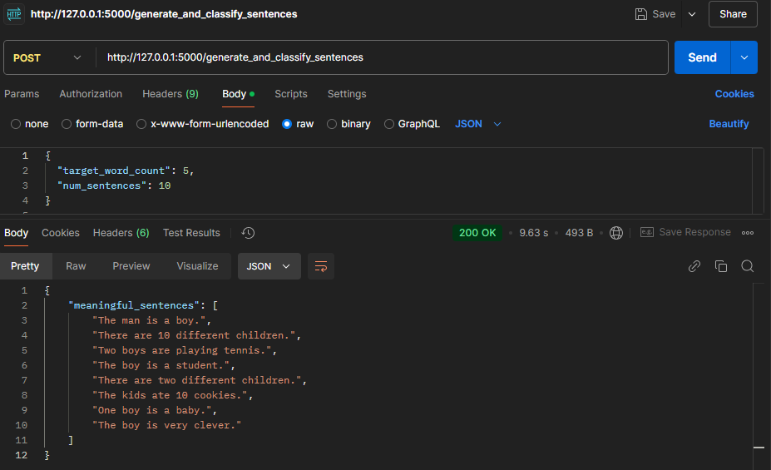
User Requirements and Evidence of Completion
View and learn personalized lessons
Generate sentences with specified complexity
Check for meaning
Display only meaningful sentences
Perform quizzes and assess the performance
Present the sentences as a questionnaire
Pronounce the words
Check for accuracy
Perform chromatic variation test
Perform color test
Highlighted tasks are planned to completed before Project Presentation 2
IT21318320 | Silva T.U.D | 24-25J-233

Slide 71
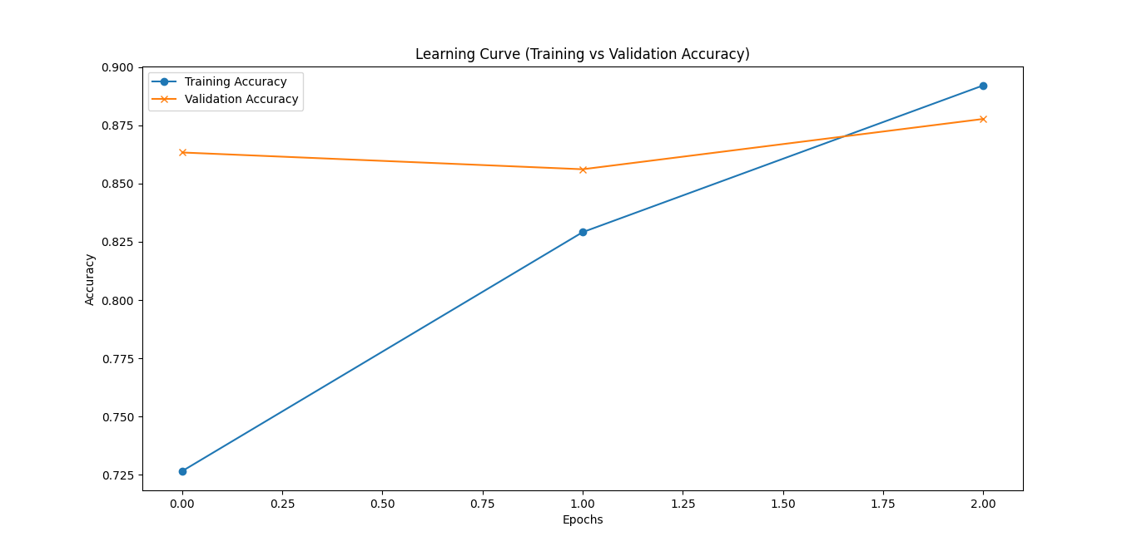
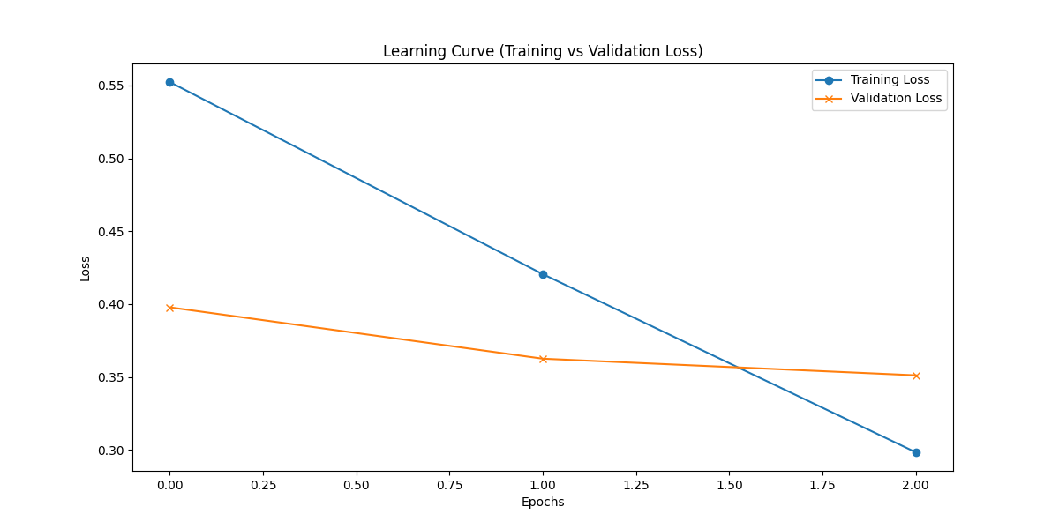
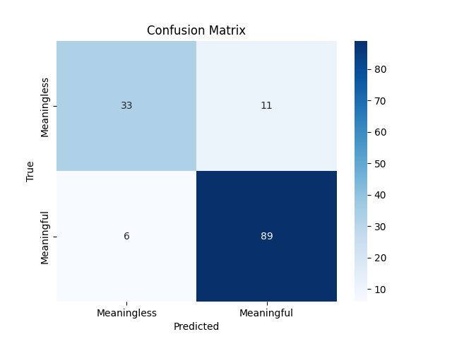
Evidence of Completion
IT21318320 | Silva T.U.D | 24-25J-233

Slide 72
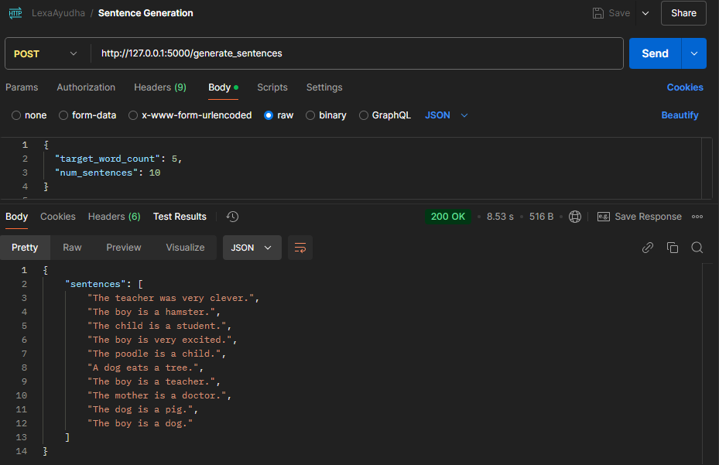
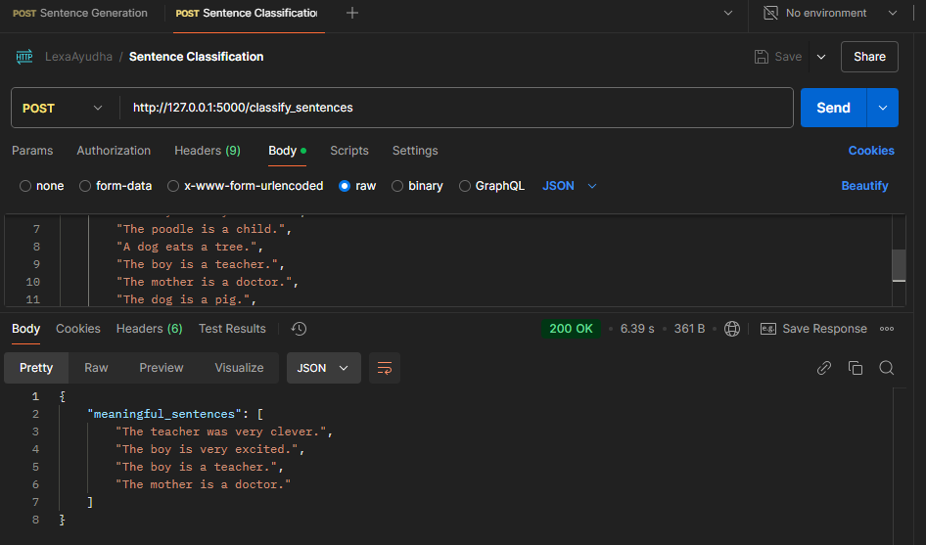

Evidence of Completion
IT21318320 | Silva T.U.D | 24-25J-233

Slide 73


Evidence of Completion
IT21318320 | Silva T.U.D | 24-25J-233

Slide 74
Risk Mitigation
Identified Risks & Mitigation Strategies
​
Model performance Issues
Regular tests
Fine tuning the model periodically
Keep a default set of appropriate sentences.
​
Insufficient meaningful sentences
in the dataset
Increase the dataset with additional
labeled data.
​
Unauthorized access to the system could
lead to misuse
Implement authentication and authorization mechanisms to secure endpoints
​
Interface may not be
user-friendly or accessible
Conduct usability testing with diverse users and incorporate feedback
IT21318320 | Silva T.U.D | 24-25J-233

Slide 75

Future Direction
Fine tuning the model
Chromatic variation test
Color Test
IT21318320 | Silva T.U.D | 24-25J-233

Slide 76
COMMERCIALIZATION ASPECT

Slide 77


Monetizing Aspect
Subscription based business model
Donation enabled

Slide 78

Marketing Aspect
Primary Target Audience: The parents of learning divergent adolescents
Secondary Target Audience: Educators, Special education professionals
Digital Marketing
Social media marketing
Blogs
Email marketing
Partnerships
Collaboration with schools
Collaboration with dyslexic educational institutes

Slide 79
Budget
Description | Cost
Vercel – Frontend Deployment | Free Tier
Render – Backend Deployment | Free Tier
Azure Cosmos DB | Free Tier(25GB Lifetime)
Azure Blob Storage | $0.018 per GB (First 5GB Free)
Mongo DB (Development)
Google speech to Text | 1 hour free for month | $0.006 per 15 seconds over 60 mins up to 1 million mins
Azure App Services – Application Deployment | Free Tier
Google Colab Pro | $9.99

Slide 80
THANK YOU
AI-based Personalized Rehabilitation for Dyslexia and Dyscalculia Adolescents

Slide 81

ANY QUESTIONS?

